Slide 1
Before start, let's download the necessary packages
https://github.com/ XS-MLVP/tutorial-records
IF Local Laptop
Connect Our WiFi
SSID: UnityChip
Password: UnityChip2025
Download Image Tar and Load
wget http://192.168.219.118:9527/ download/envfull.tar.gz
gzip –d envfull.tar.gz
docker load -i envfull.tar
IF Remote server
Pull Images from Github
Waiting for actions, just a moment.
How to run the container
$ sudo docker run -it --network host ghcr.io/xs-mlvp/envfull:latest

Slide 2




UnityChip Verification: Open-Source Multi-Language Hardware Verification
Yunlong Xie, Fangyuan Song
May 11th, 2025

Slide 3

Contents
How Software Verify Hardware Designs
What We Gain from This Approach
Why Verify Hardware with Software

Slide 4
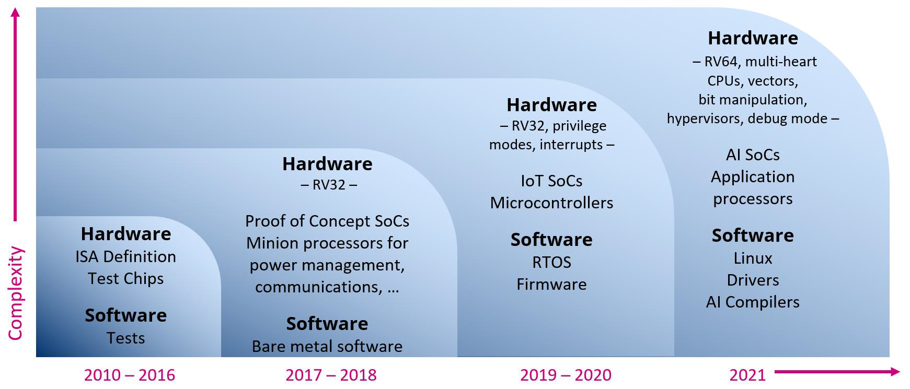
Open-source Hardware is the future.
Source: Calista Redmond, RISC-V Open EraofComputing, Linux Foundation Spring Member Meeting, April 2021. https://riscv.org/wp-content/uploads/2021/05/RISC-V-New-Era-04-19-2021.pptx

Slide 5
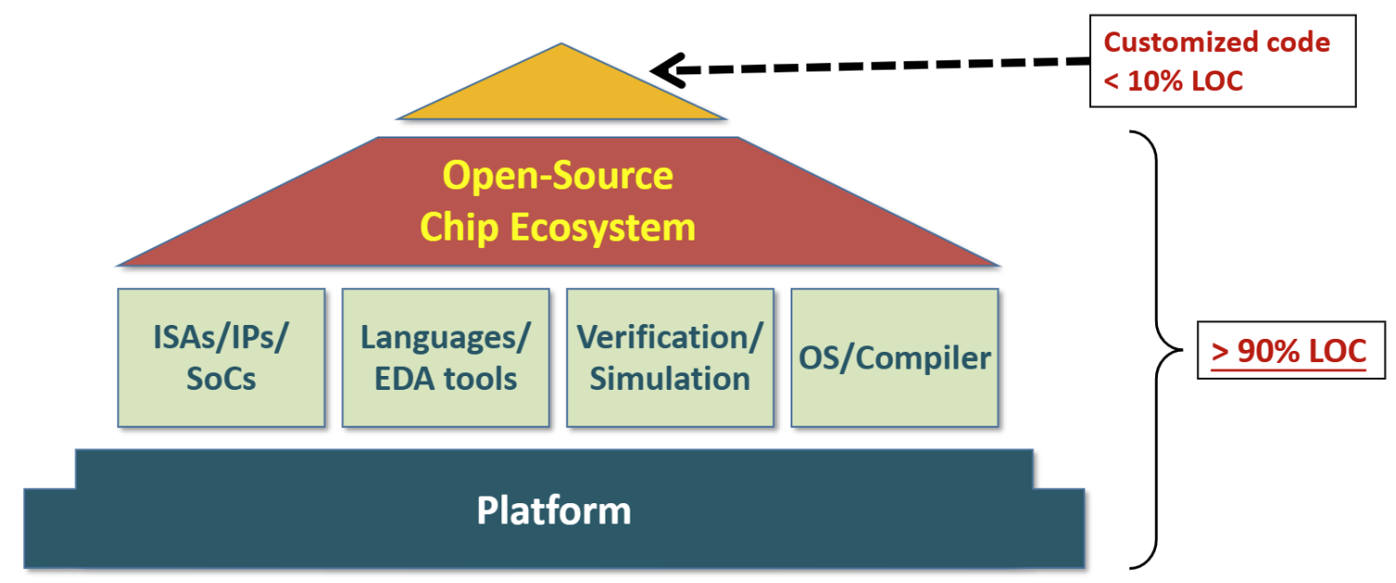
Open-source Hardware: A Growing Ecosystem
A growing open-source hardware ecosystem is built on RISC-V.
Shared infrastructure reduces the cost of IP, EDA tools, and engineering, lowering the barrier to chip development.
Source: Yungang Bao, The Four Steps to An Open Source Chip Design Ecosystem, ACM SIGARCH Visioning Workshop, June 2019. https://sites.google.com/view/agile and open hardware
Notes:
Inspired by open-source software, the industry is building an open-source chip ecosystem based on the RISC-V ISA. By creating shared infrastructure, it reduces the cost of IP, EDA tools, and engineering resources, ultimately lowering the barrier to chip development.

Slide 6
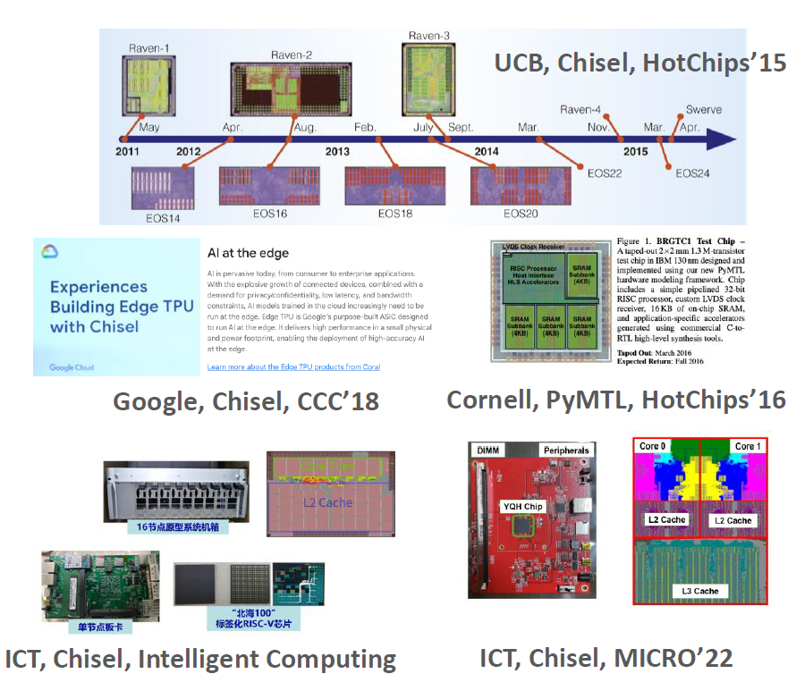

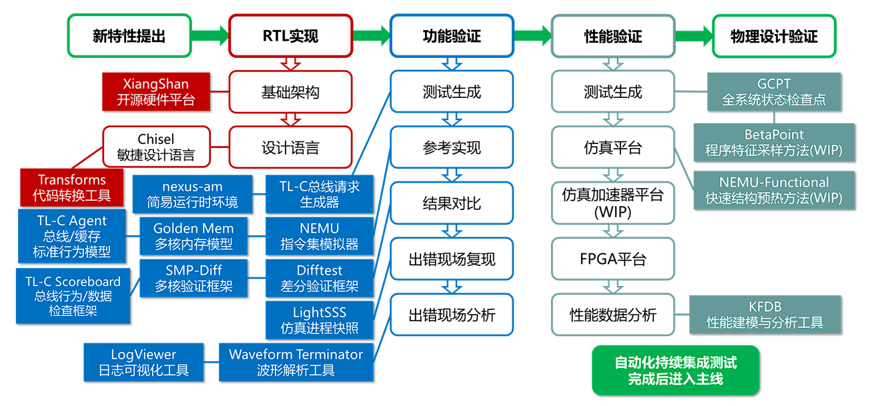
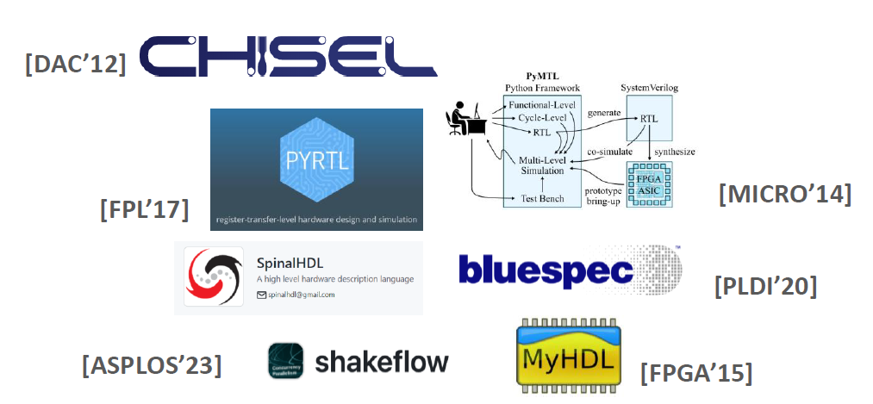
An Agile Loop for Hardware Development
Verification
Release
Design
Optimization
Automatic Perf. Bug Detection [HPCA’21]
Aiding Perf. Validation with ML [ISPASS’24]
Top-Down [ISPASS’14], Interval model [HPCA’10]
TIP [MICRO’21], TEA [ISCA’23]
Notes:
As a result, an agile methodology has grown up around the development of open-source hardware.
Great cycle

Slide 7
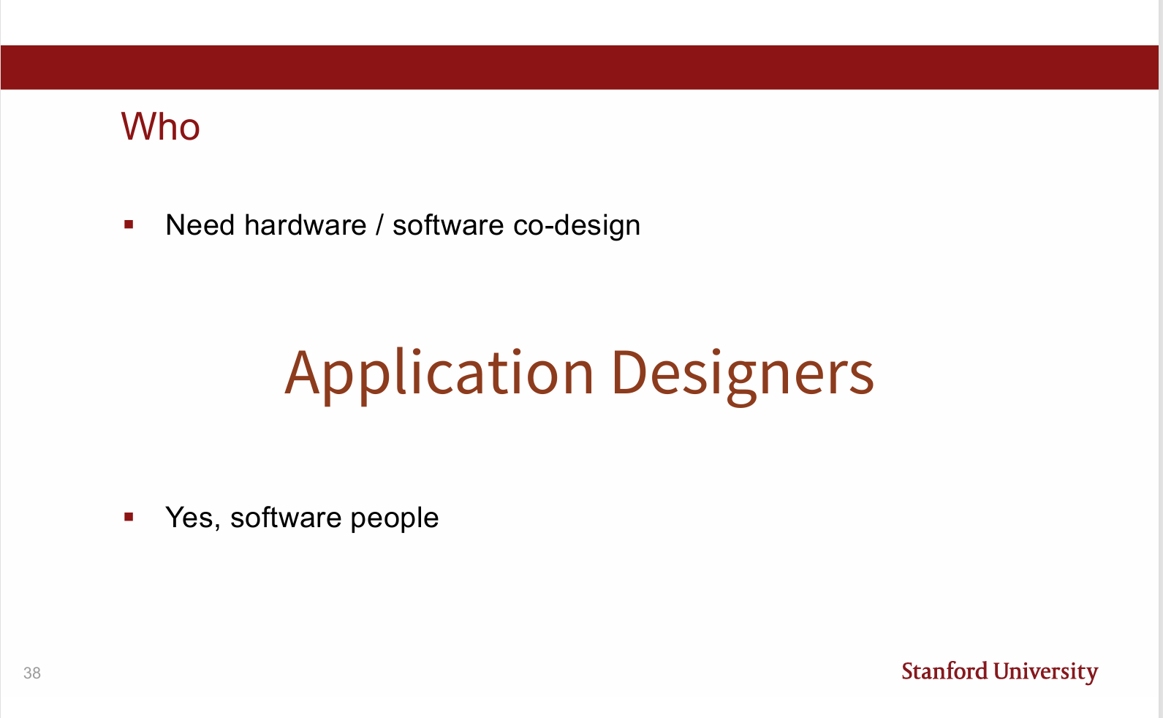
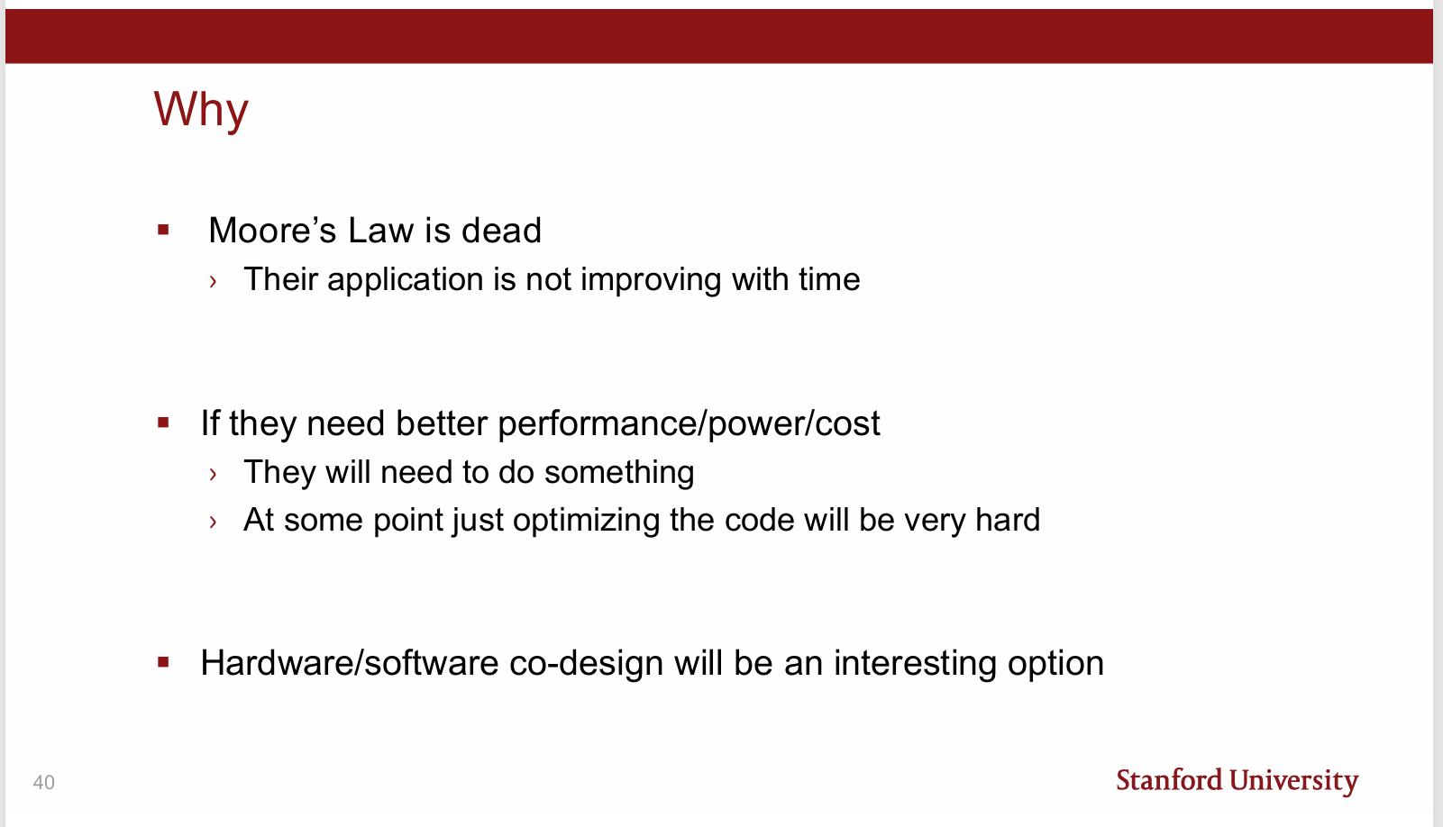
The Storm Ahead: Software-Hardware Co-Design
Tens of thousands of software developers could become part of hardware design.
Source: Prof. Mark Horowitz, Life Post Moore’s Law: The New CAD Frontier, July 19, 2023.
https://aha.stanford.edu/life-post-moores-law-new-cad-frontier
Notes:
Everything seems to be okay, but...

Slide 8
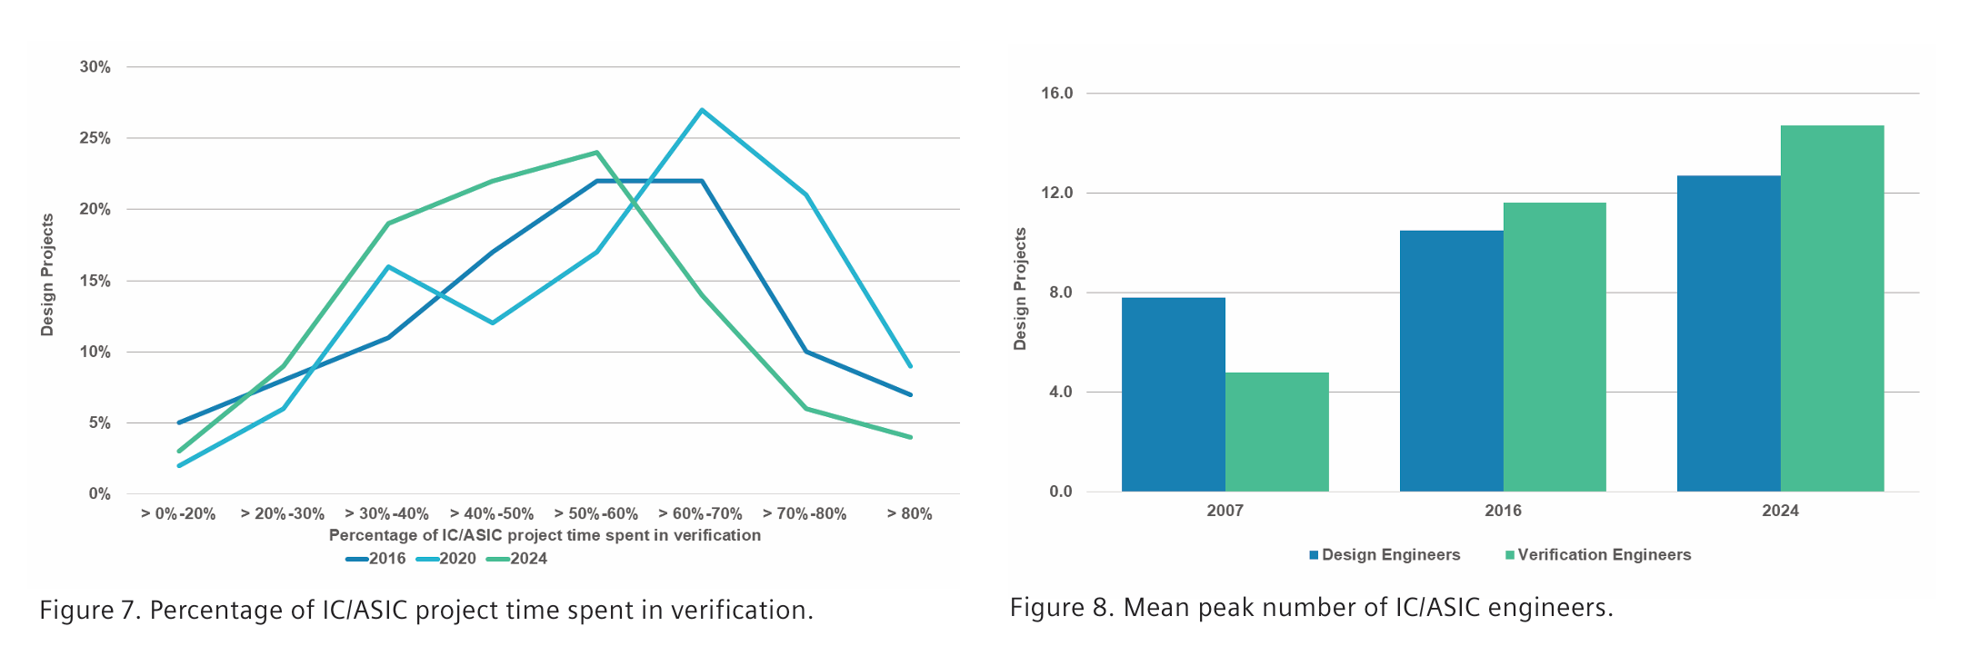
Rethinking Verification for the Future
Verification already takes huge effort. Doubling design means doubling the pain?
Source: SIEMENS, 2024 Wilson Research Group IC/ASIC functional verification trend report
https://resources.sw.siemens.com/zh-TW/white-paper-2024-wilson-research-group-ic-asic-functional-verification-trend-report/

Slide 9

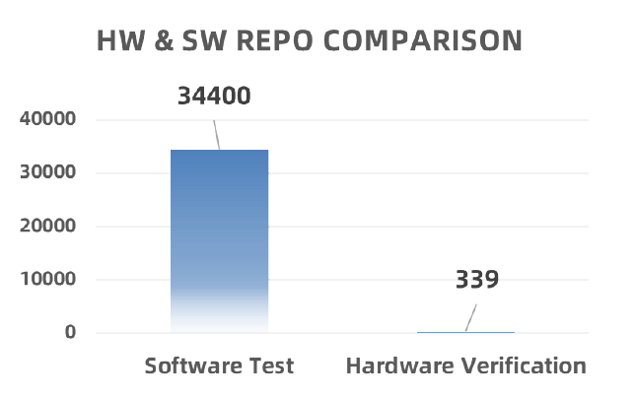
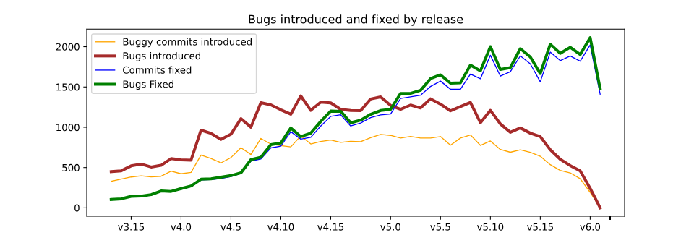
Hardware-Software Co-Verification
Invite Software Developers to Verify Hardware!
Software development thrives on community, hardware verification can too!
Left picture source: Jonathan Corbet, Bugs and fixes in the kernel history, December 8, 2022
https://lwn.net/Articles/914632/
Notes:
Learn from the Linux Community:
Mature and extensive testing practices
High levels of community-driven quality assurance
Compare Open Source Ecosystems:
Abundant software open-source projects
Growing but fewer hardware open-source projects

Slide 10
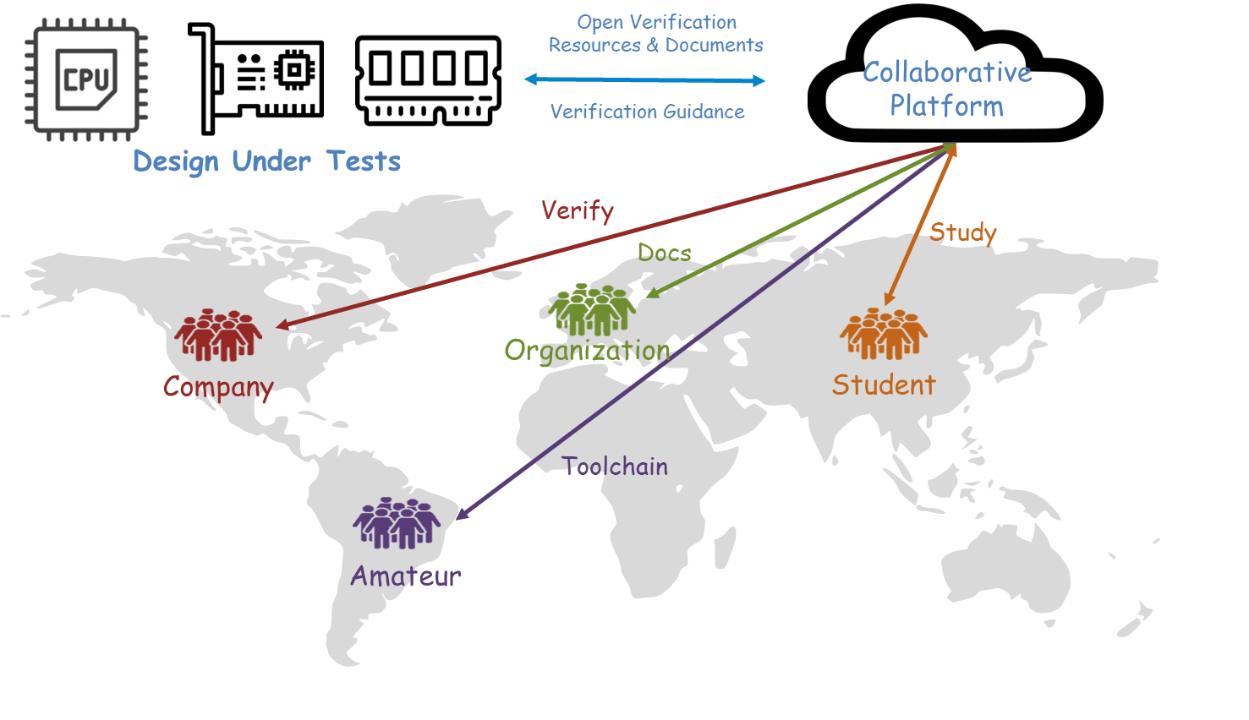
Verification Together

Slide 11
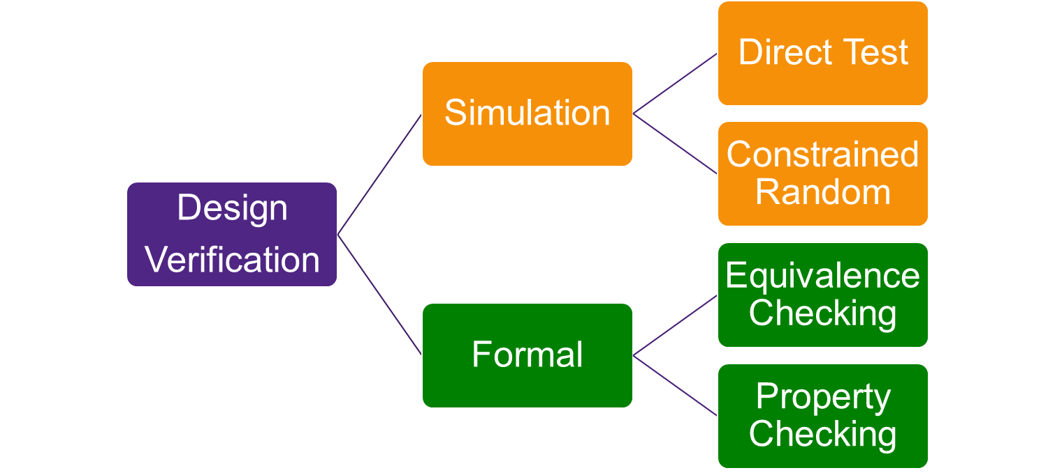

Why Simulation Leads in this Way

Slide 12
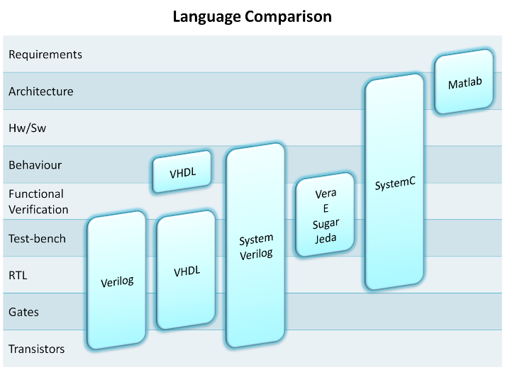

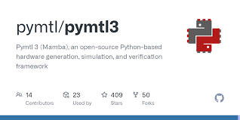

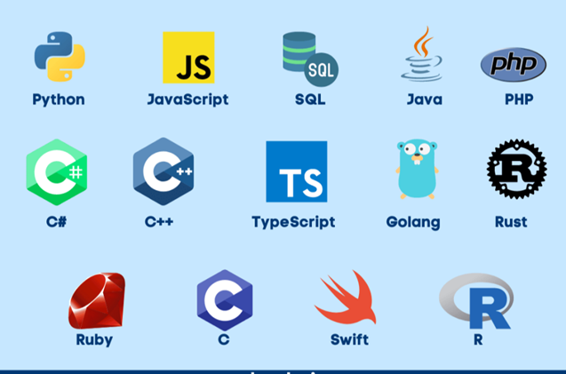
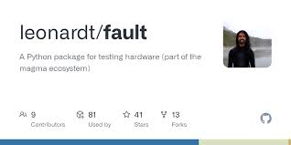
Bridging the Gap: Enabling Software-Driven Verification
Different Languages
SW Languages

Slide 13
Three Approaches to Verification
Software-Generated Hardware Code (e.g. Fault)
✦ Hardware Compatibility: ★★★★★ (As good as traditional HVL)
✦ Software Flexibility: ★☆☆☆☆ (Extremely limited third-party libraries)
Software as a Callback Library for Hardware (e.g. Cocotb)
✦ Hardware Compatibility: ★★★★☆ (Only require VPI)
✦ Software Flexibility: ★★★☆☆ (Conflict with asynchronous libraries)
Software-Driven Hardware Control (e.g. PyMTL)
✦ Hardware Compatibility: ★★★☆☆ (DPI and Simulation control API)
✦ Software Flexibility: ★★★★★ (All libraries)

Slide 14
Why Software-Driven Verification Matters?
✅ Focus on:
​Software Compatibility​ (OS, libraries, APIs, 3rd-party integrations)
​Developer-Centric Usability​ (Toolchain accessibility, debugging experience, multi-threads)
🚫 Avoid:
Software as hardware callback (unstable Delta Cycles)
Automatic HDL code generation (HVL limitation still applies)

Slide 15
We've made some technical optimizations.
These optimizations are used to handle some complex scenarios more efficiently.
Simultaneously improve better compatibility with existing hardware ecosystems.

Slide 16
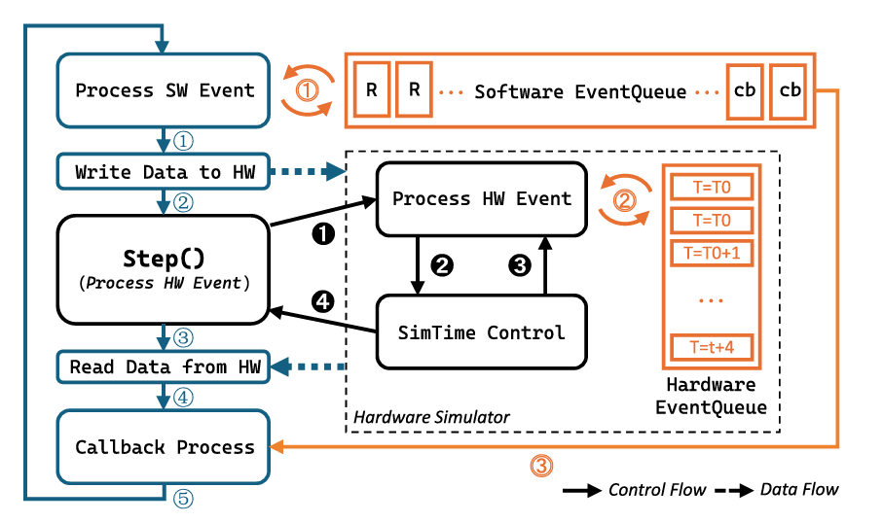
Event-Driven: Bridging Software-Driven to Hardware
Event-Driven in Hardware
Simulator
Transaction-level Verification
Event-Driven in Software
Asynchronous programming
RPC (gRPC, HTTP…)
Bridging
Time-Sorted Software Events
Handle transactions as if they were RPCs.

Slide 17
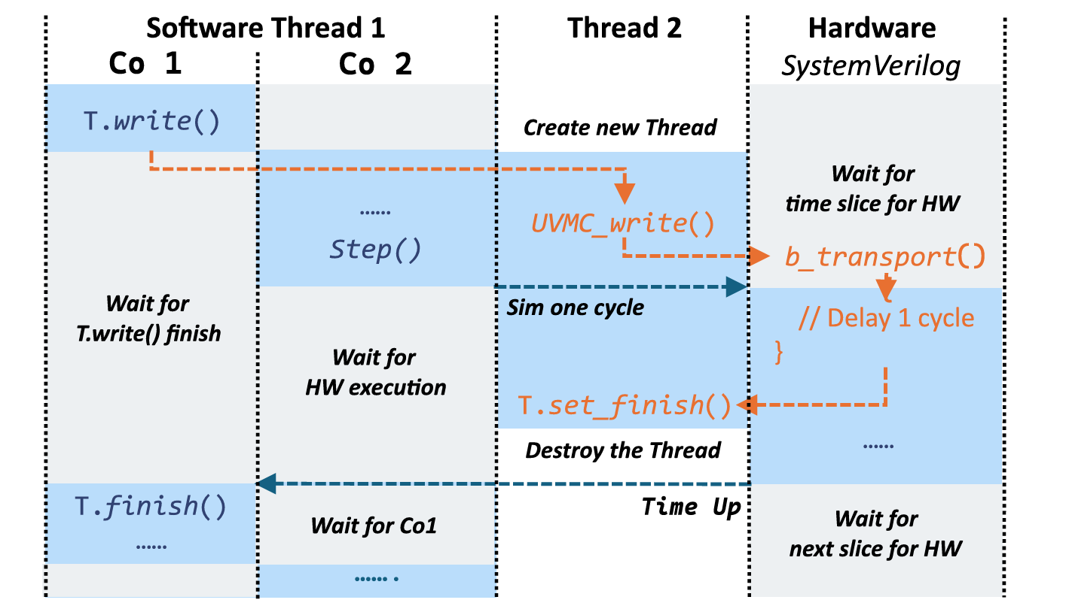
Socket: Integrating Traditional Verification IP
Socket for TLM 2.0 (HW)
UVM Verification IP
non_blocking_transport
blocking_transport
Socket for Network (SW)
send/recv
asynchronous/sync
Communicate directly with UVM Socket in the software.

Slide 18
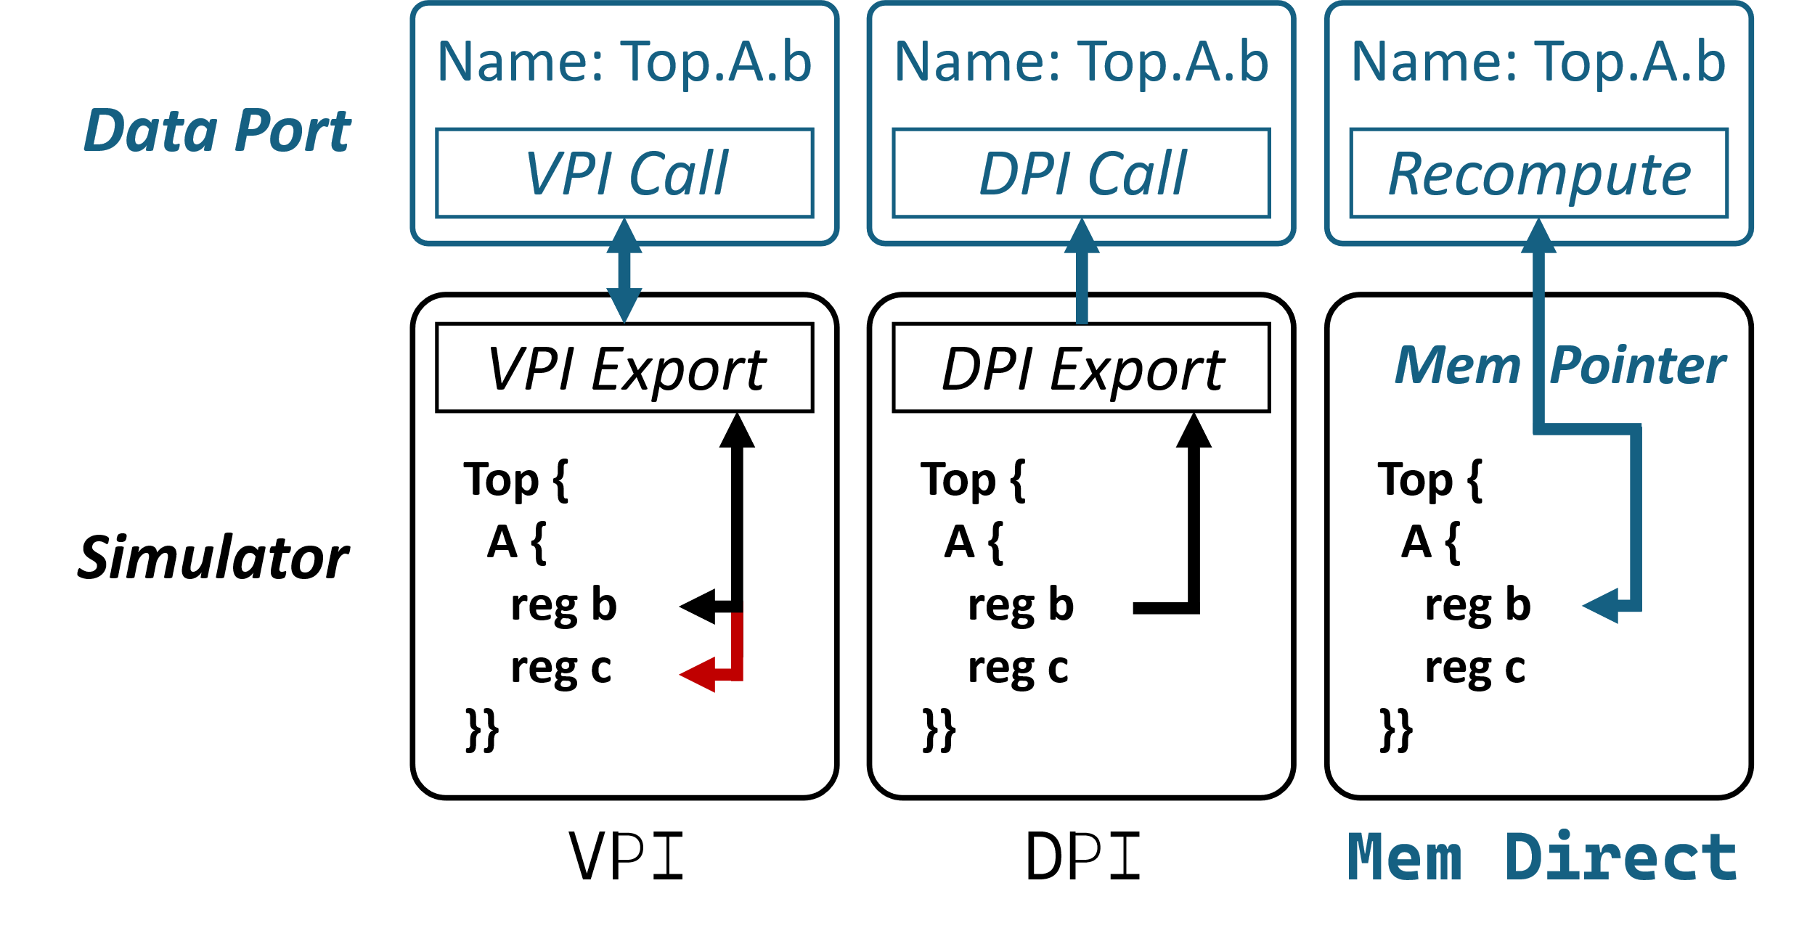
Mem Direct: On-demand Signal Access
Signal Accessibility
VPI, all signal
DPI, compilation dynamic
Faster Memory Direct
Pointer to Simulator Variables
Runtime Dynamic
Up to 95% speedup
Non-intrusive, ymal-based reflection

Slide 19
We also realized some benefits from these optimizations.
We achieved
Better performance.
Easier Programming
A more compatible framework.
A novel processor verification method.

Slide 20
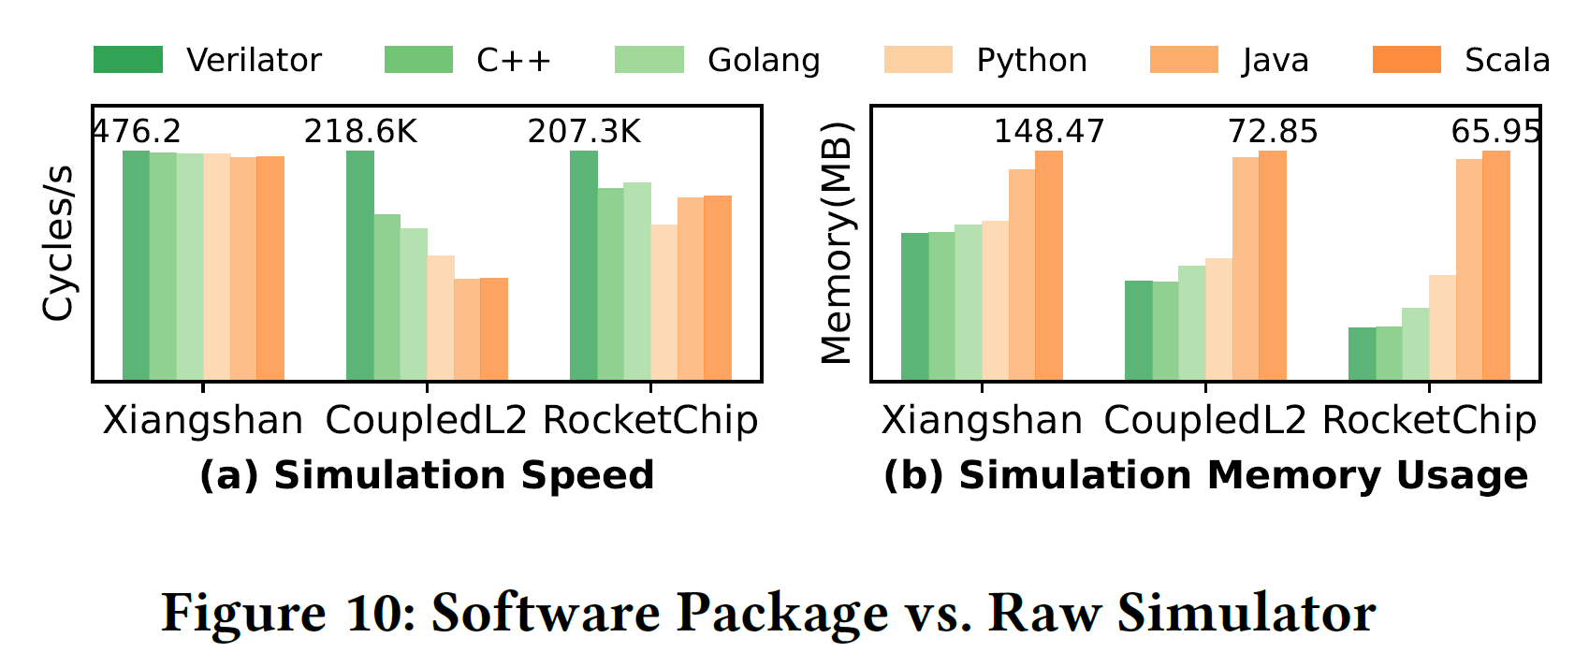
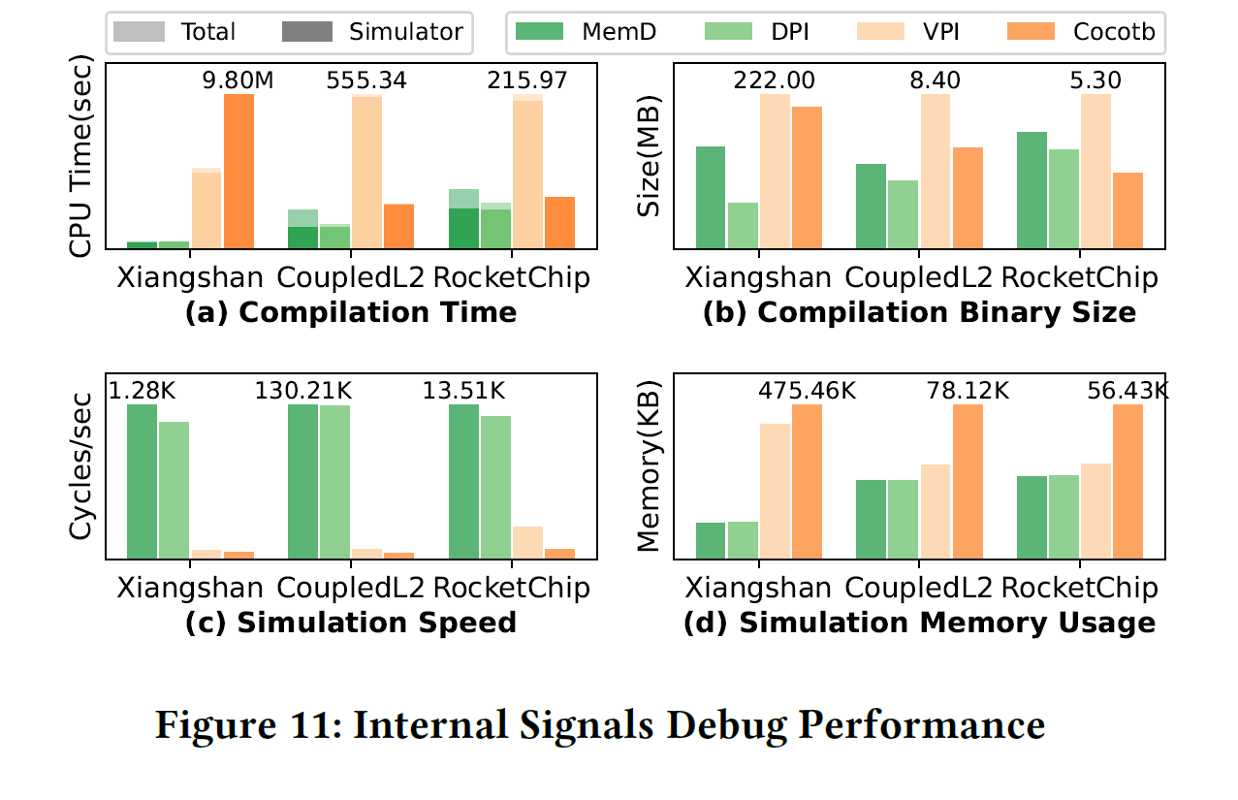
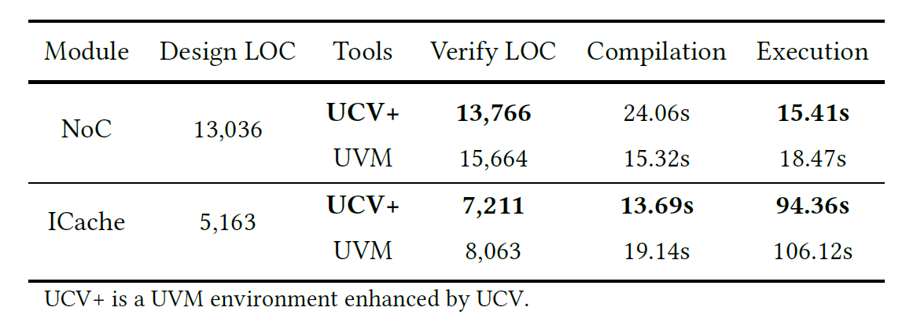
Performance: Faster Compilation & Verification

Slide 21
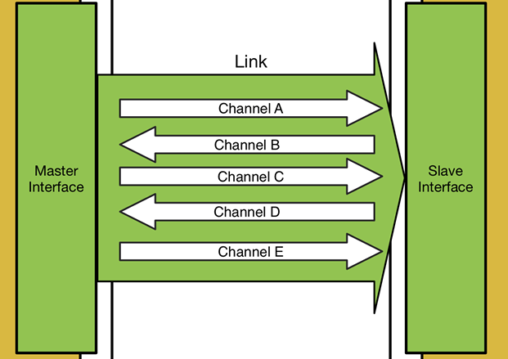
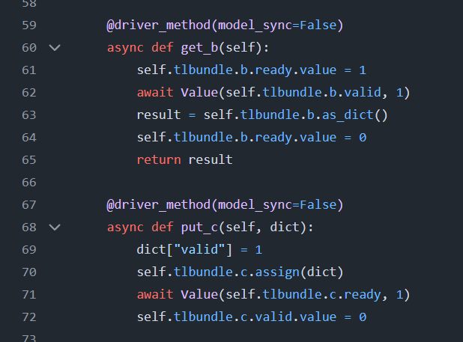
Event-Driven: From Polling Hell to Reactive Verification

Slide 22
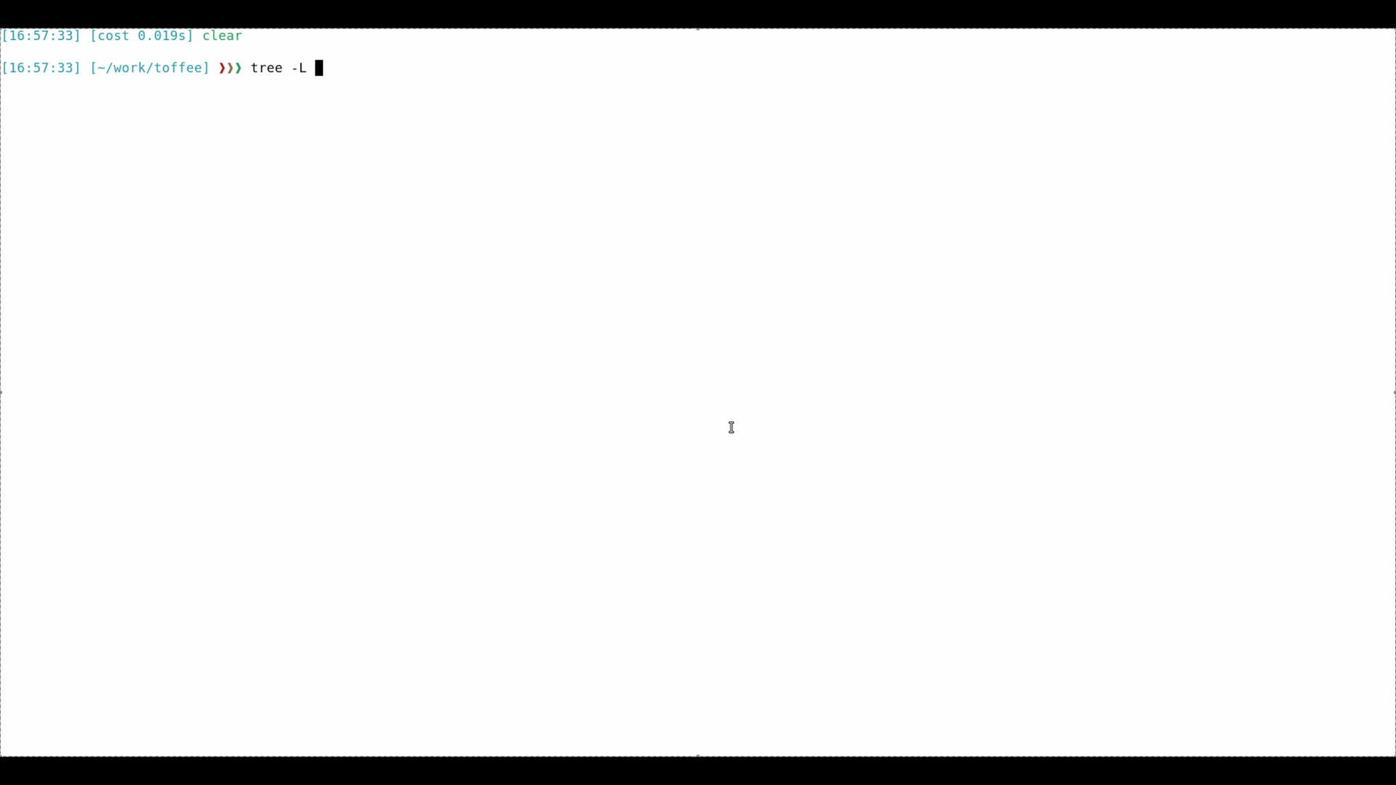
Toffee: Verification Frameworks

Slide 23
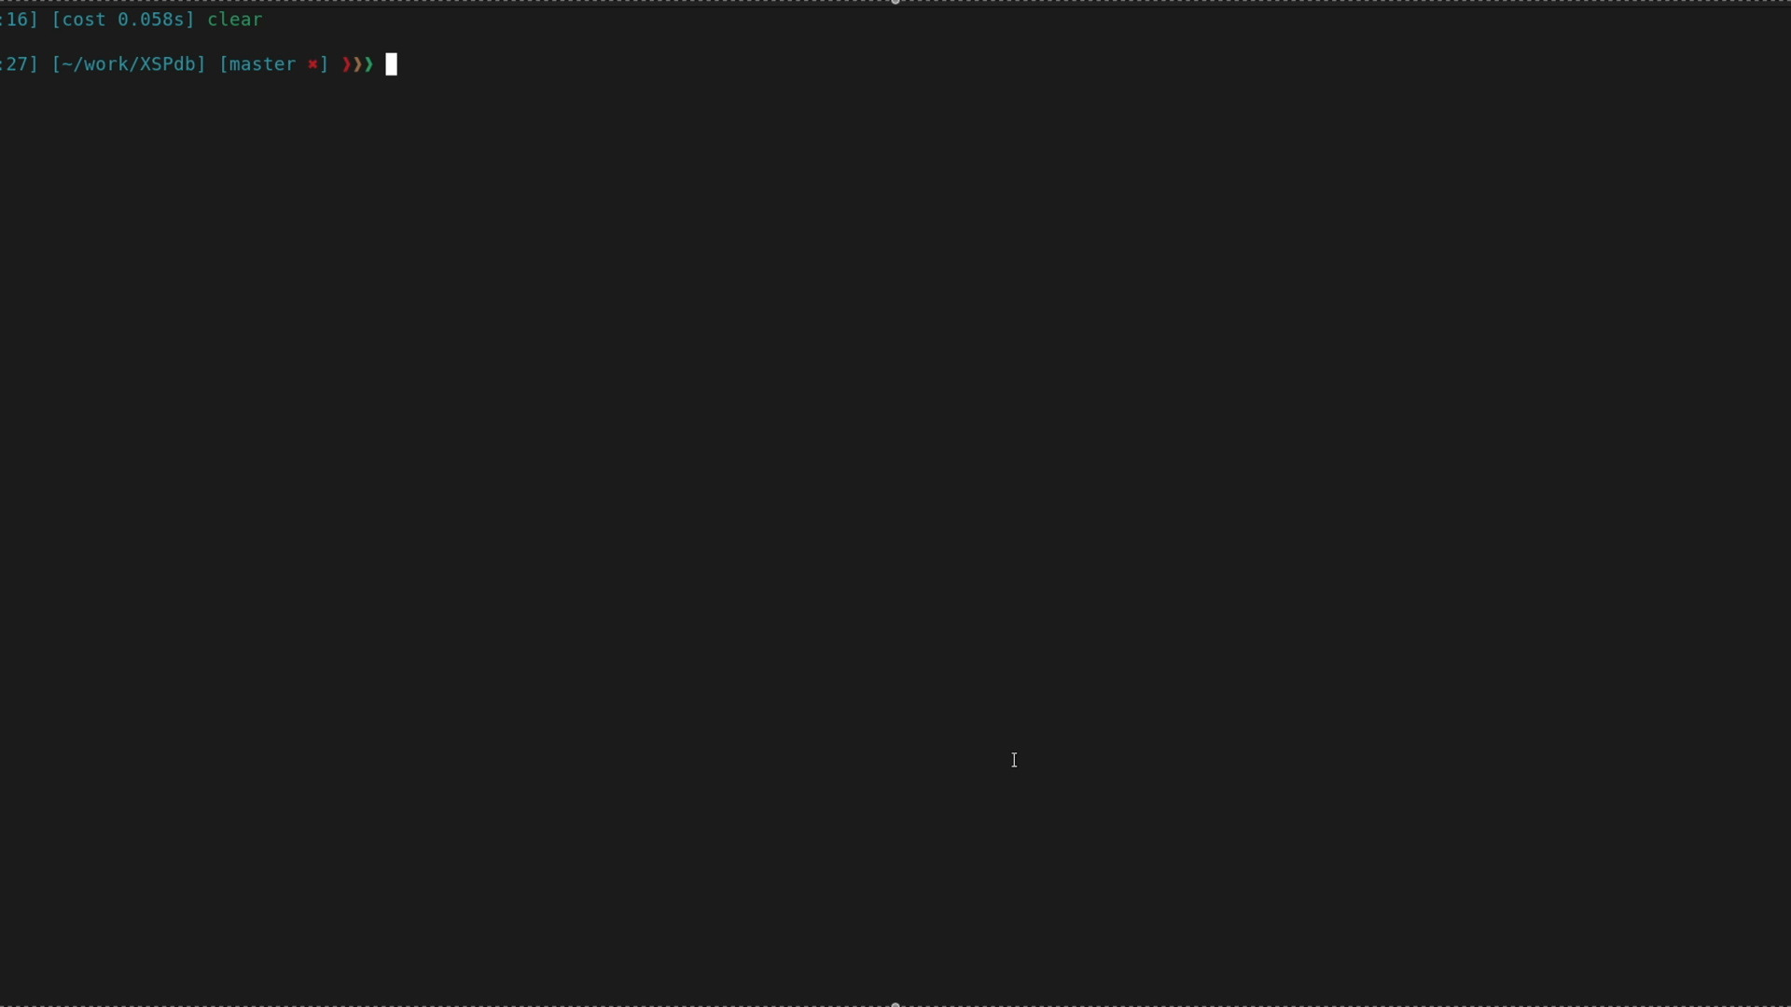
XSPdb: Bringing GDB Philosophy to Hardware

Slide 24
It's time to hands on.
We provide images that include code samples and environment.
https://github.com/XS-MLVP/tutorial-records
Go through the workflows including:
Picker (basic tool)
Toffee (framework)
XSPdb (cpu debug)
How it works
How to use
Example: Adder
Signal Grouping
Coverage Collection
Asynchronous
Example: Cache
RTL debug like GDB
Interactive Debugging
Example: XiangShan

Slide 25
Before start, let's download the necessary packages
https://github.com/ XS-MLVP/tutorial-records
IF Local Laptop
Connect Our WiFi
SSID: UnityChip
Password: UnityChip2025
Download Image Tar and Load
wget http://192.168.219.118:9527/ download/envfull.tar.gz
gzip –d envfull.tar.gz
docker load -i envfull.tar
IF Remote server
Pull Images from Github
docker pull ghcr.io/xs-mlvp/envfull:latest
How to run the container
https://github.com/XS-MLVP/tutorial-records/blob/master/tutorials/README.md
OR
Next Page

Slide 26
Prerequisites
Start and run the image
# Local Computer with Shell
$ docker run -it --network host ghcr.io/xs-mlvp/envfull:latest
# Remote server with SSH
@local$ ssh -L 51202:localhost:51202 <your-server-user>@<your-remote-server-ip>
@remote$ docker run -itd --network host ghcr.io/xs-mlvp/envfull:latest sudo /usr/sbin/sshd –D
@local$ ssh -p 51202 user@localhost

Slide 27
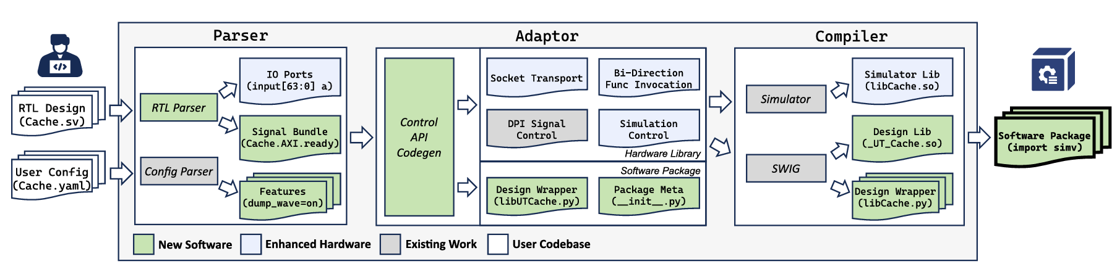
How
27

Slide 28
Simple Example
Quick-start
$ cd /workspace/code-samples/picker/
$ ./Adder/release-verilator.sh --lang python
# ./example/Adder/Adder.v \
--autobuild false -w Adder.fst --sname Adder \
--tdir picker_out_adder/Adder --sdir template $@
# cp example/Adder/example.py picker_out_adder/Adder/python/
# cd picker_out_adder/Adder && make EXAMPLE=ON

Slide 29
Adder Example
result​
# [test 114507] a=0x7adc43f36682cffe, b=0x30a718d8cf3cc3b1, cin=0x0 => sum: 0x12358823834579604399,dut_sum: 0x12358823834579604399 [test 114508] a=0x3eb778d6097e3a72, b=0x1ce6af17b4e9128, cin=0x0 => sum: 0x4649372636395916186, dut_sum: 0x4649372636395916186 [test 114509] a=0x42d6f3290b18d4e9, b=0x23e4926ef419b4aa, cin=0x1 => sum: 0x7402657300381600148, dut_sum: 0x7402657300381600148

Slide 30

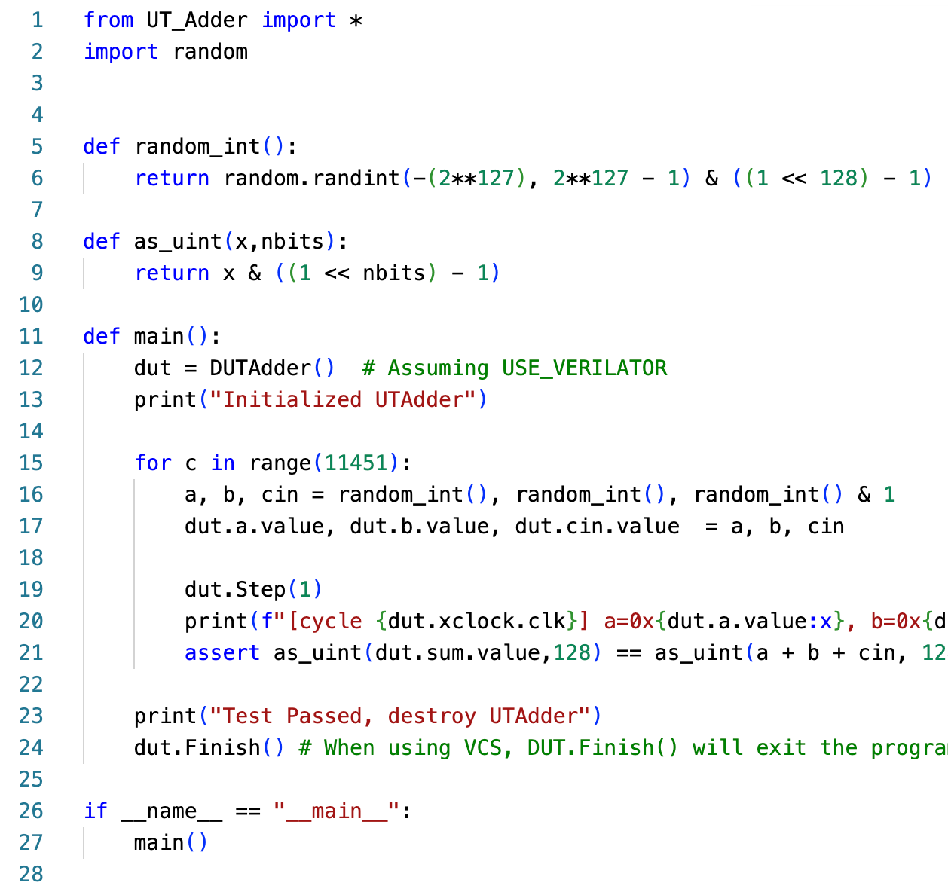
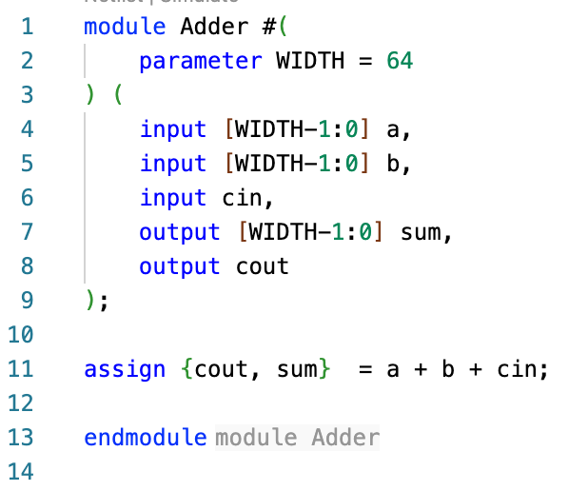
Adder Example
RTL
Verilator
DUT.so
Shared libs
Python
Test Case
VCS
# import RTL as python module
# create DUT
# assign values
# assert result

Slide 31
Cache Example
Cache signals
prefix | count
clock reset | 2
io_flash io_empty io_in_* | 25
io_mmio_* | 7
io_metaReadBus_* | 21
…

Slide 32
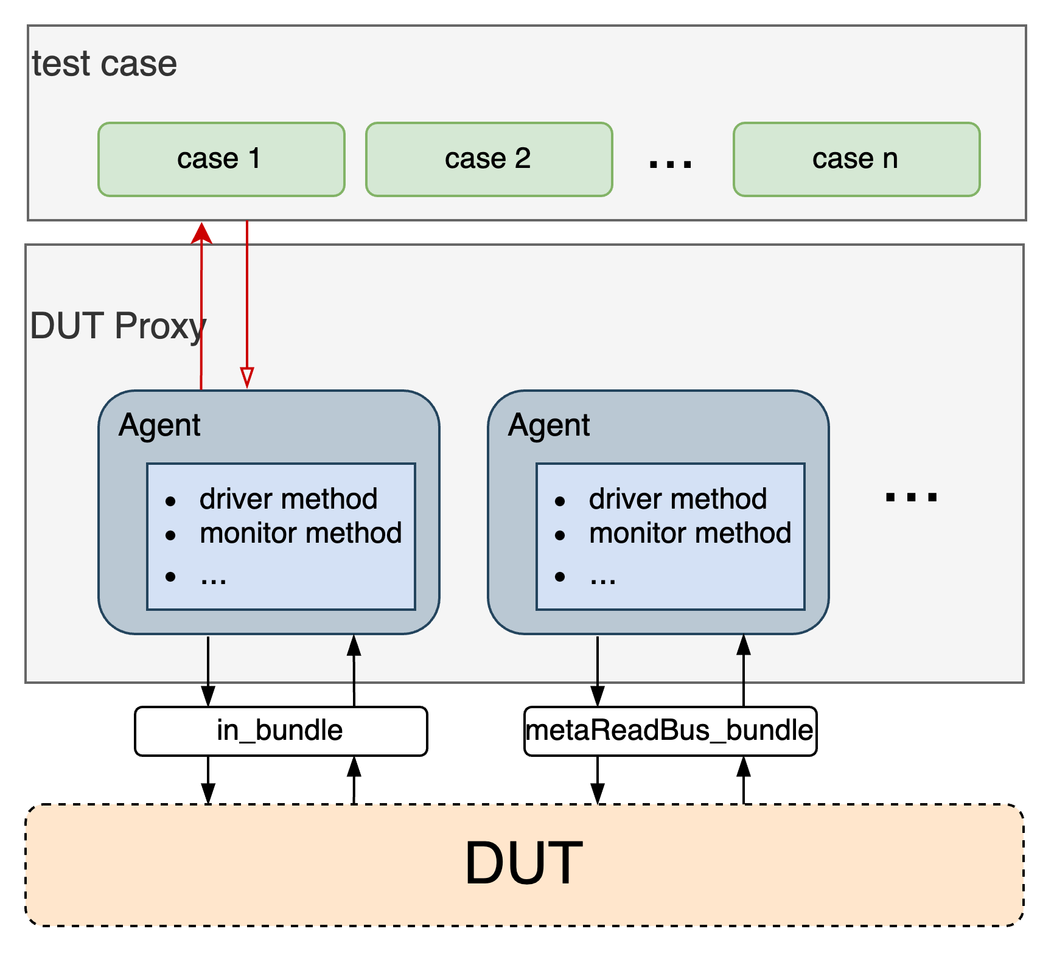
开源众包验证实践效果
Toffee​
UVM like verifaction framework
Bundle, Agent, Env
Testcase Manage
Coverage
Line coverage
Function Coverage
Asynchronous
Async, await
Executor
32
Notes:
Next, I will explain what can be achieved through ​​picker​​. In the previous PPT slides, we demonstrated how ​​picker​​ drives a simple adder. However, when driving cache verification, we realized that building a ​​structured, reusable, and maintainable verification framework​​ is essential for managing components, organizing test cases, and providing verification reports. While ​​picker​​ offers foundational hardware interaction capabilities, a more comprehensive framework and methodology are required.
To address this, we developed ​​toffee​​—a high-level verification framework inspired by methodologies like UVM. It provides:
​​1， Standardized verification components​​
​​2，Verification report and coverage support​​
​​3，Enhanced asynchronous support​
接下来，将为大家介绍可以通过picker做些什么，在前几页的ppt中，我们通过picker驱动了一个简单的加法器，然后在驱动cache时会发现，我们构建一个结构化、可复用、易于维护的验证框架用于管理组件，管理测试用例，提供验证报告，picker为我们提供底层的硬件交互能力，还需要更完善的框架和方法学支持，为此我们开发了tofee，一个高级语言验证框架，借鉴了UVM等验证方法学的思想，可以为验证提供1.标准化的验证组件 2.验证报告和覆盖率支持 3.更好的异步支持

Slide 33
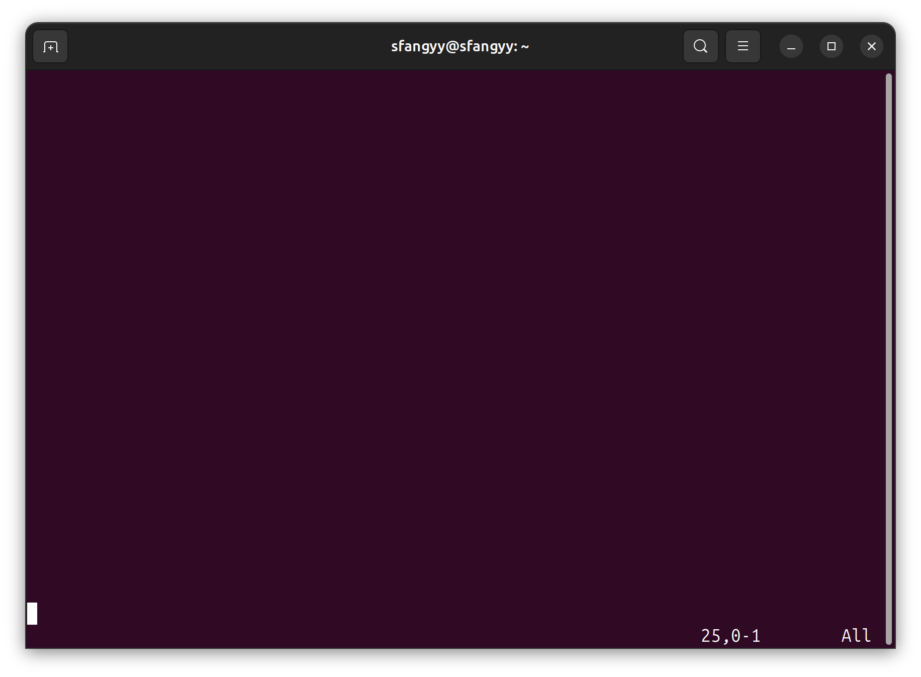
开源众包验证实践效果
Prerequisites
# Enter your toffee dictionary
$ cd /workspace/code-samples/toffee
# Project Structure
$ tree –L 2 .
.
|__ Makefile
|__ src
| |__ env
| |__ func_coverage.py
|__ rtl
|__ test
|__ test_smoke.py
# toffee compoment
# manage test case
33
Notes:
Before we begin the formal presentation, let's navigate to the toffee demonstration directory. Execute cd /workspace/code-samples/tofee, then run tree -L 2 . to view the Toffee project structure.
The Toffee component code resides in the src/env directory, which contains four core elements:
Bundle​​
​​ Agent​​
​​ Env​​ Next, the test folder contains all test cases for validation.

Slide 34
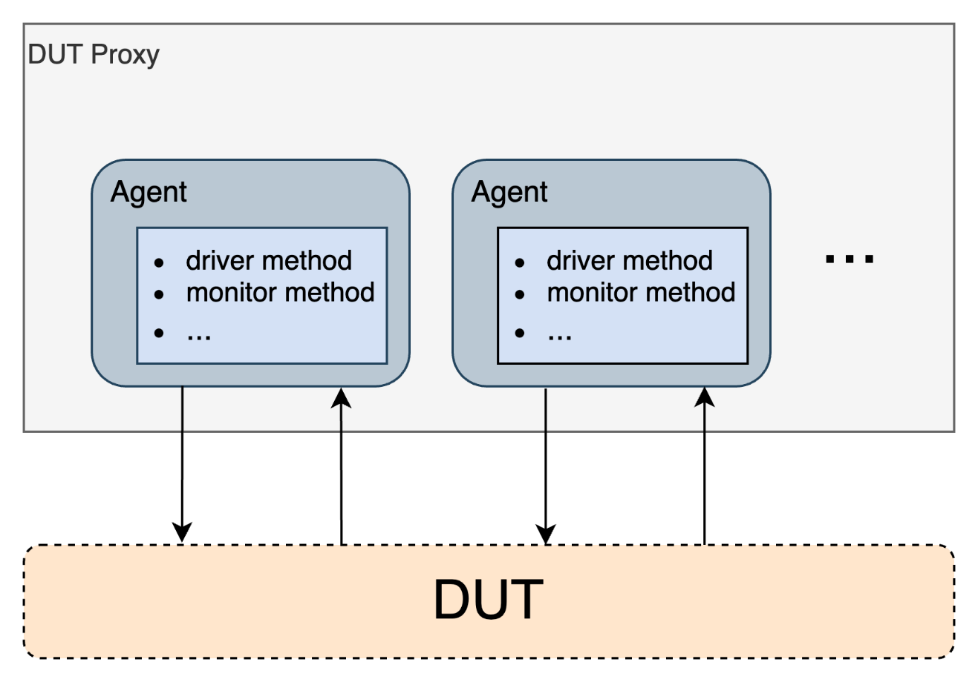
开源众包验证实践效果
Bundle
port prefix is too long
Dut`s port has renamed
io_in_ready
io_in_valid
io_in_valid
…
io_metaReadBus_req_ready
io_metaReadBus_req_valid
i0_metaReadBus_req_bits_setIdx
…
34
Notes:
Let's begin with the first component: ​​Bundle​​. In cache designs, we often encounter numerous ports with lengthy naming prefixes or volatile configurations, particularly when porting testbenches across different DUTs. How do we resolve this?

Slide 35
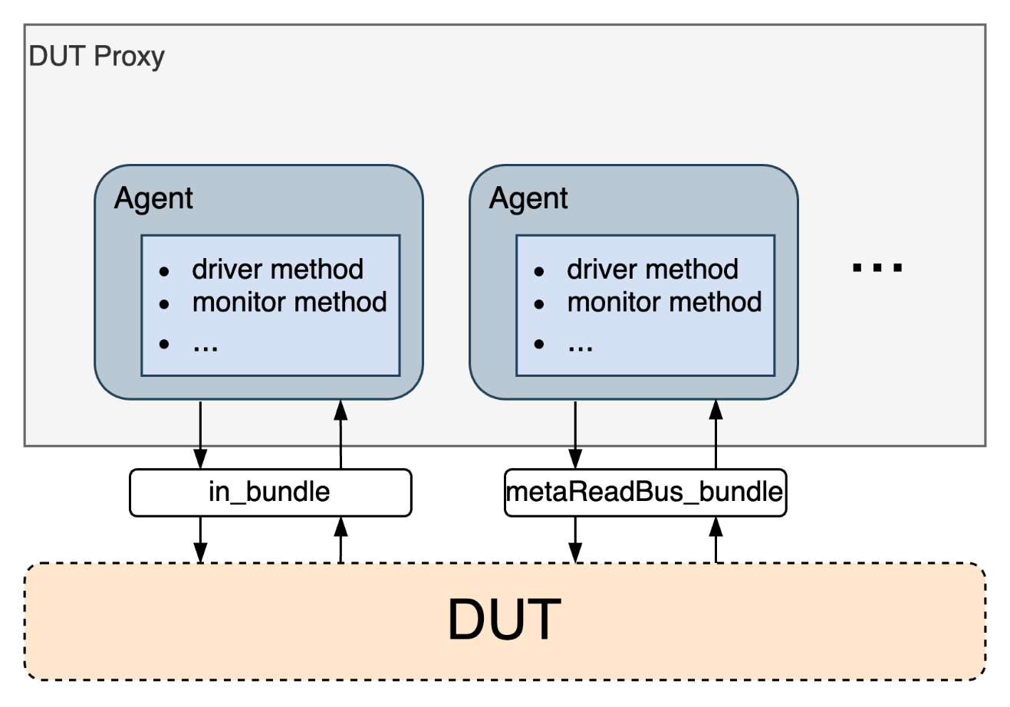
开源众包验证实践效果
Bundle
Interface encapsulation and abstraction
Decoupling Agent and DUT
Structured Access Signal
io_in_ready
io_in_valid
io_in_valid
…
In_bundle
io_metaReadBus_req_ready
io_metaReadBus_req_valid
i0_metaReadBus_req_bits_setIdx
…
Bus_bundle
35
Notes:
Bundle provides an architectural solution by:
​​Encapsulating related DUT ports​​ (all signals of metabreadbus) into a logical unit
Serving as an abstraction layer between Agents (to be discussed next) and the DUT
​​Decoupling Agent implementation​​ from specific port naming conventions and hierarchical structures
Enabling ​​hierarchical partitioning​​ of DUT interfaces for clearer signal access

Slide 36
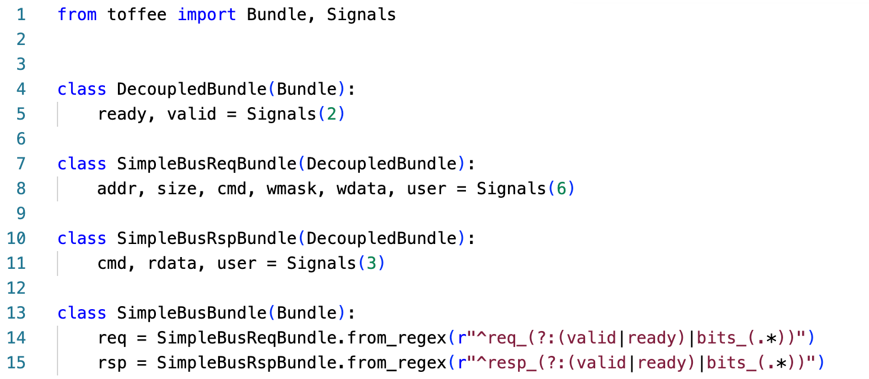
开源众包验证实践效果
Bundle
# bundle code
$ cat src/env/bundle.py
# define sub bundle
# connect bundle
1. from_prefix(‘io_’)
2. from_regex
3. from_dict
36
Notes:
You can Execute cat env/bundle.py

Slide 37
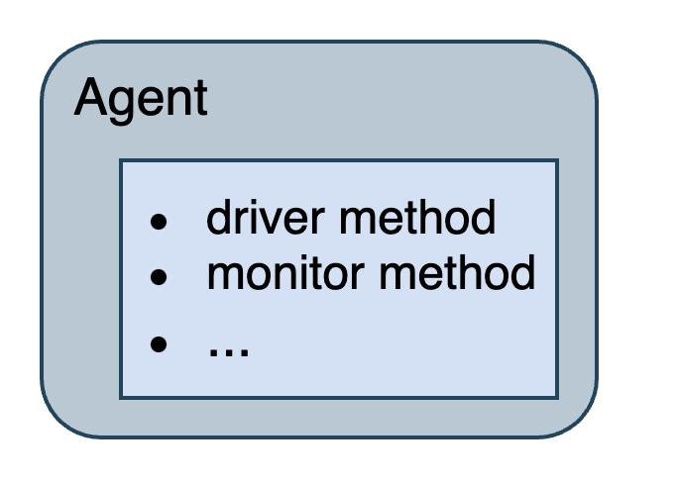
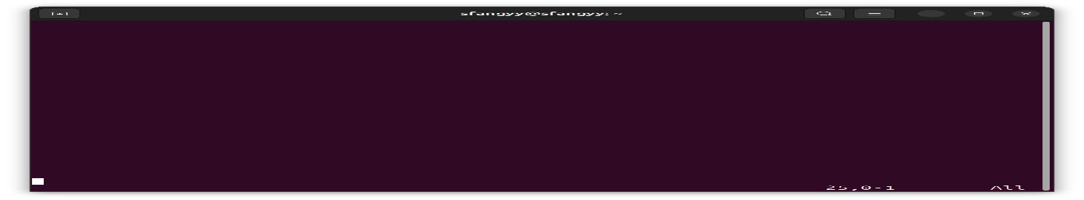
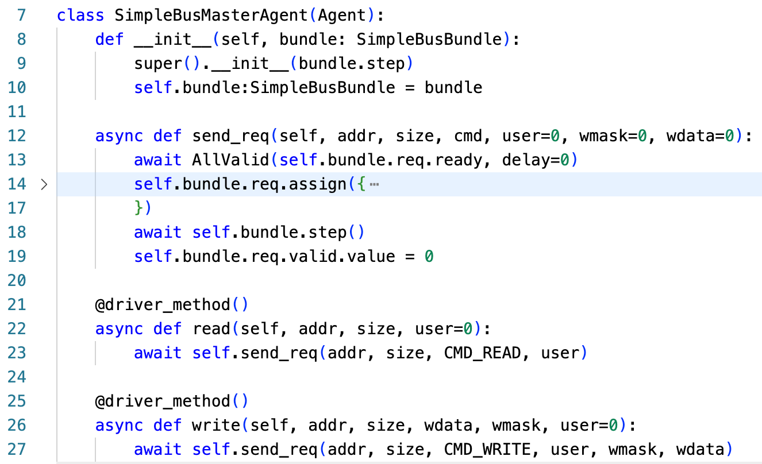
开源众包验证实践效果
Agent
# agent code
$ cat src/env/simplebus_agent.py
Initial bundle
Drive DUT
Monitor DUT
37
Notes:
Above the Bundle component resides the ​​Agent​​ layer, which implements monitoring and driving function for the DUT. This component essentially serves as an integrated entity that combines the functionality of UVM‘s agent, driver, and monitor.you can by input cat src/env/simplebus_agent.py to view how to define a agent

Slide 38
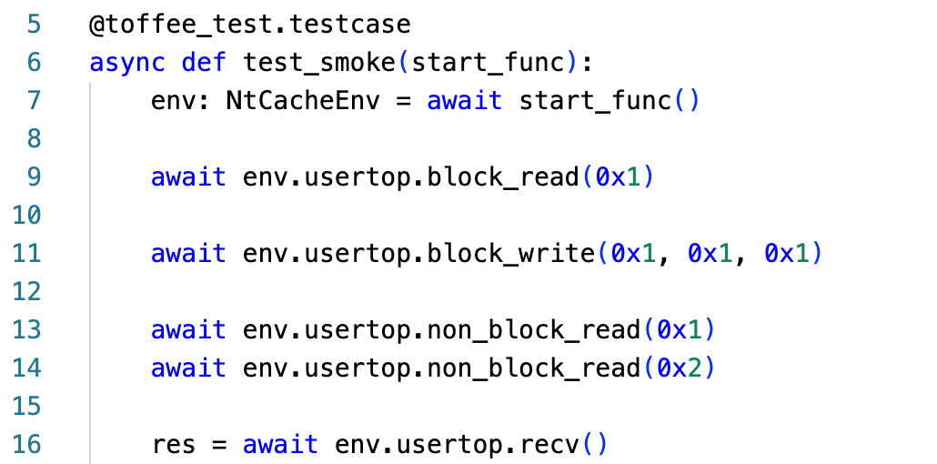
开源众包验证实践效果
Testcase
# test code
$ cat test/test_smoke.py
# run
$ make test
Report.html
38
Notes:
Finally, in the test code section, we can use methods from components like Env and Agent to construct test cases. Additionally, Python decorators are employed to systematically organize and manage these test cases
In addition, pytest offers comprehensive features and a wide range of plugins. As the volume of test code grows, adopting toffee and toffee-test can significantly enhance verification efficiency and optimize the verification workflow experience
This concludes the basic Toffee verification environment setup. after completing these configurations, execute the make test command to initiate verification. A comprehensive report containing waveform diagnostics and coverage analysis will be generated in the /report directory.
For immediate review during this presentation, please refer to Slide 15 where we've preloaded:

Slide 39
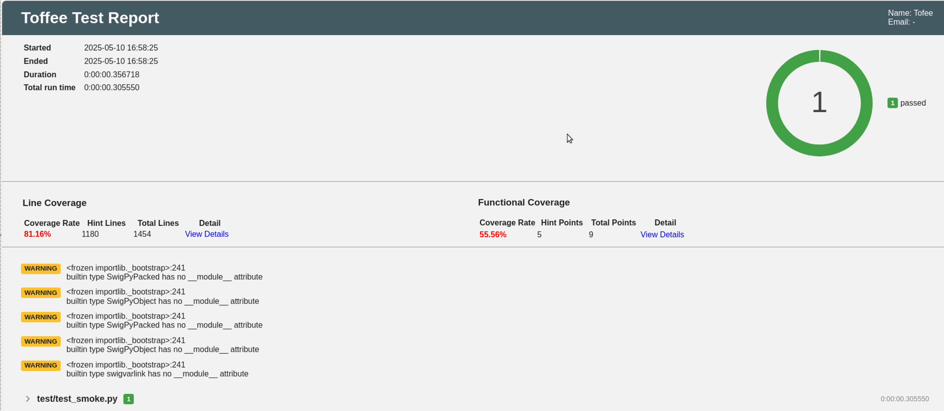
开源众包验证实践效果
Test Report
Line Coverage
Functional Coverage (?)
39
Notes:
The report contains two main coverage information: line coverage (provided by Picker) and functional coverage. Line coverage is provided by picker and we can use toffee to manage the

Slide 40
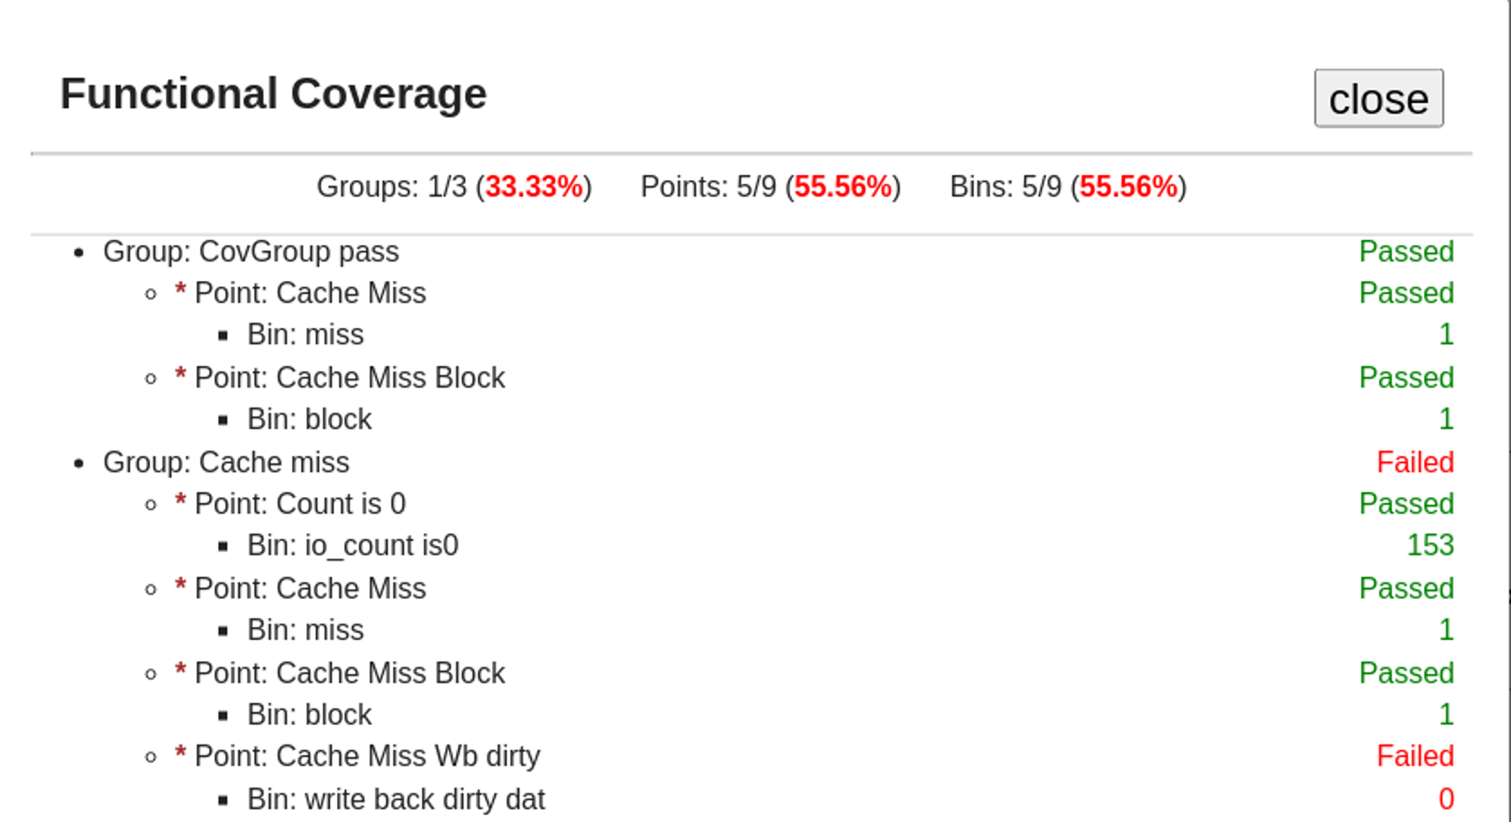
开源众包验证实践效果
Function Coverage
CovGroup
A logical container used to organize a set of related coverage items
CovPoint
Defined within CoviGroup, used to monitor a specific behavior
CovBin
Defined within CoviPoint, it represents the specific state expected to be achieved by the coverage point
40
Notes:
To define functional coverage in Toffee, the framework implements a three-tier hierarchy: ​​Group​​, ​​Point​​, and ​​Bin​​. Coverage data is only collected when all sub-level criteria are satisfied.

Slide 41
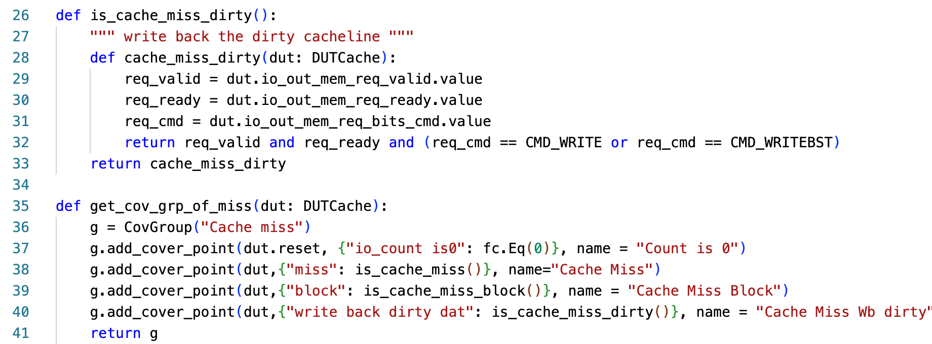
开源众包验证实践效果
Function Coverage
# Define Function Coverage
$ cat src/function_coverage.py
Define CovGroup
Define CovPoint
Define CovBin
41
Notes:
To view the coverage file, execute the xxx command.
You can import relevant functions and use a function to define a coverage group
And then by add_cover_point to define a coverage point in CovGroup
You can define multiple ​​coverbins​​ within a ​​cover point​​ to monitor any content you need to observe

Slide 42
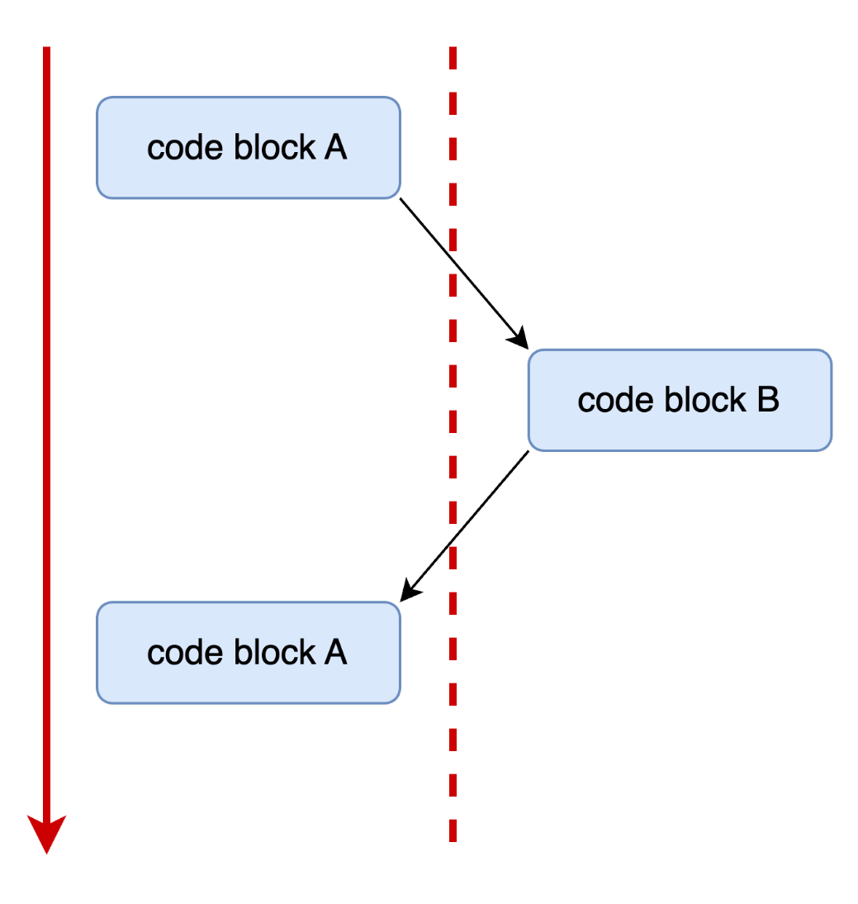
Asynchronous
Notes:
In the previous ​​test​​ example code, we noted that the async keyword is added before function definitions. This is because the core of the ​​Toffee​​ framework is built on a ​​coroutine-based asynchronous programming model​​ for coroutine functions.
Hardware verification naturally involves extensive ​​concurrent activities​​ and precise ​​timing synchronization​​. For example:
We need to simultaneously drive multiple ​​DUT interfaces​​, monitor various signals, wait for specific clock edges or events, and interact with reference models.
If traditional ​​synchronous blocking programming​​ is used (where a function call must fully return before proceeding), the code would struggle to express such concurrency or result in inefficient simulation (as a wait operation blocks all other activities).
While callback functions can handle asynchronous events, they often fragment control flow, leading to "​​callback hell​​" and making the code difficult to read and maintain.
在之前 toffee-test 的示例代码中，我们注意到函数定义前都添加了 async 关键字。这是因为 Toffee 框架的核心是基于协程的异步编程模型协程函数。
硬件验证天然涉及大量并发活动和精确的时间同步。例如，我们需要同时驱动多个 DUT 接口，监测各种信号，等待特定的时钟边沿或事件发生，与参考模型进行交互等。如果使用传统的同步阻塞式编程（即一个函数调用必须等待其完全返回后才能执行下一步），代码会难以表达这种并发性，或者导致仿真效率低下（因为一个等待操作会阻塞所有其他活动）。虽然可以使用回调函数来处理异步事件，但这往往会导致控制流变得碎片化，容易陷入所谓的“回调地狱”，代码难以阅读和维护

Slide 43
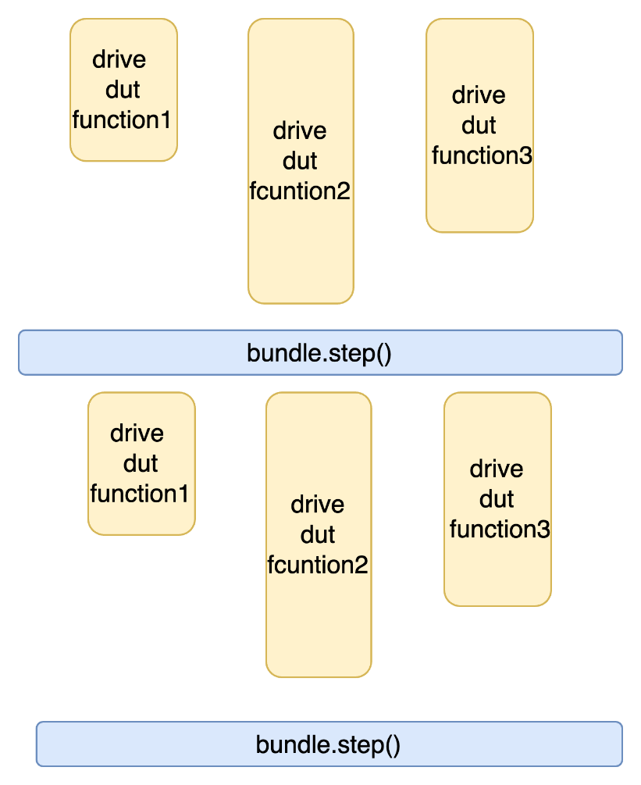
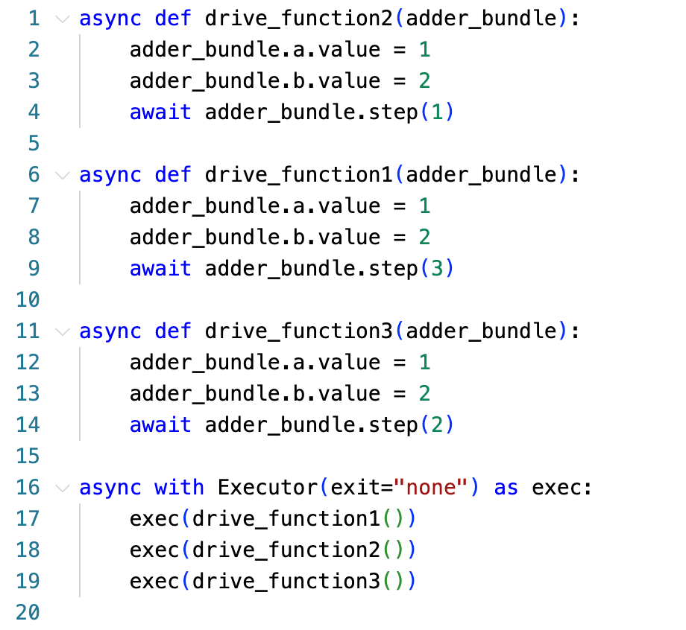
Asynchronous
Sim Time
Notes:
Building upon this foundation, Toffee introduces a coroutine-based clock management mechanism. The framework centrally controls clock progression, where invoking bundle.step(n) specifies after how many clock cycles to return execution results. For parallel operations, users can dispatch them to executors – their execution flow is demonstrated in the leftside architectural diagram.

Slide 44
开源众包验证实践效果
XSPdb
Purpose
Need Some High-Level Information in Verifaction
​​pause instruction execution​​ at points of interest
​​inspect the processor state​​
XSPdb: a debugging tool for RISC-V IP cores
GDB-like interactive debugging capabilities
conditional breakpoints
real-time watchpoints
44
Notes:
In verification, we sometimes require access to higher-level information such as microarchitecture or instruction details. Additionally, there are scenarios where we need to ​​pause instruction execution​​ at points of interest and ​​inspect the processor state​​.
Solution​​ XSPdb is a specialized Python pdb-based debugging tool for RISC-V IP cores, customized for Xiangshan‘s difftest interface. It provides GDB-like interactive debugging capabilities, Prodvide Terminal command-line interface， Advanced debugging features: conditional breakpoints, real-time watchpoints, like register/memory information, it can achieve Hardware signal-level debugging interface synchronized with software execution states.

Slide 45
开源众包验证实践效果
XSPdb
# Enter xspdb dir
$ cd /workspace/code-samples/XSPdb
# Project Structure
$ tree –d –L 1
.
|__ example
|__ ready-to-run
|__ XSPython
|__ XSPdb
# init dut
# XS python packaeg
# core code
45
Notes:
Before we begin the formal presentation, let‘s navigate to the xspdb demonstration directory. Execute cd /workspace/code-samples/XSPdb, then run tree -L 2 . to view the XSPdb project structure.
You can see four folder as follows , readt-to-run is used to init dut ,XSPython is the XiangShan Python package it is generate by picker, and the finally is XSPdb,

Slide 46
开源众包验证实践效果
Basic Function
# run xspdb
$ make test
# LD_PRELOAD=XSPython/xspcomm/libxspcomm.so.0.0.1 \
PYTHONPATH=. Python3 example/test.py
Using simulated 32768B flash
[Info] reset dut complete
[Info] Loaded 145 functions form XSPdb.cmd
-> while True:
46
Notes:
This script is very straightforward. Run example/test.py using the specific ​​xspcomm​​.
When you see while true, it indicates that you have successfully launched ​​xspdb​​.

Slide 47
开源众包验证实践效果
Basic Function
# list XSPdb function
$ (XiangShan) xcmds
xapis :
xasm :
xasm_insert :
xbreak :
xload :
xwave_on :
# Print all APIs ( from XSPdb)
# assemble RISC-V assembly code
# insert code to target address
# set a breakpoint on a signal
# load a binary file into memory
# Start waveform recording
47
Notes:
Then ，You can execute xcmds to view the interfaces provided by ​​xspdb​​. Some commonly used commands include:

Slide 48
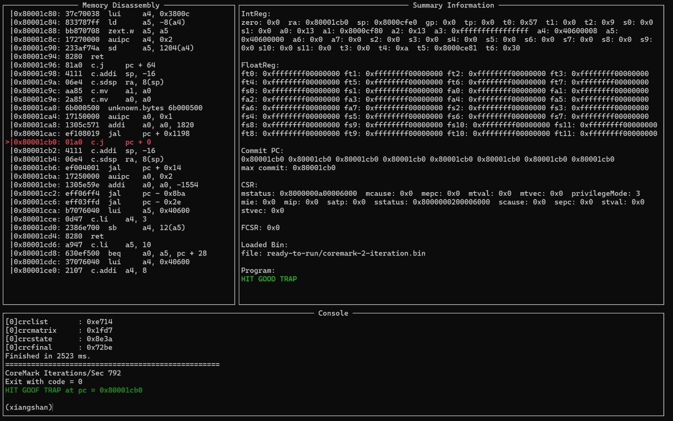
开源众包验证实践效果
Basic Function
# Enter the XSPdb graphical interface
$ (Xiangshan) xui
UI Interface
Memory Disassembly
Reg Information
Other Information
Input area
48
Notes:
The interface is divided into four sections as follows：

Slide 49
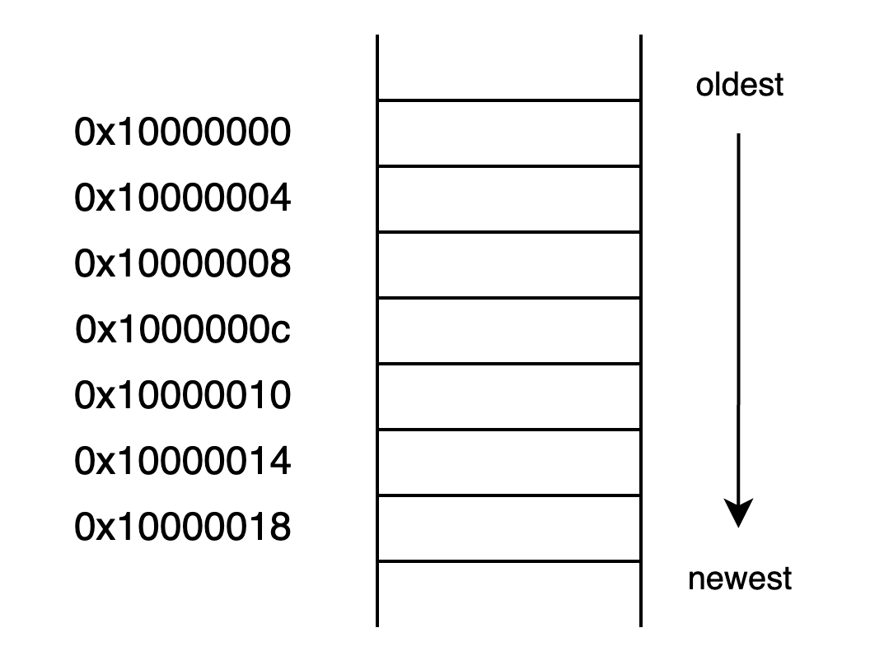
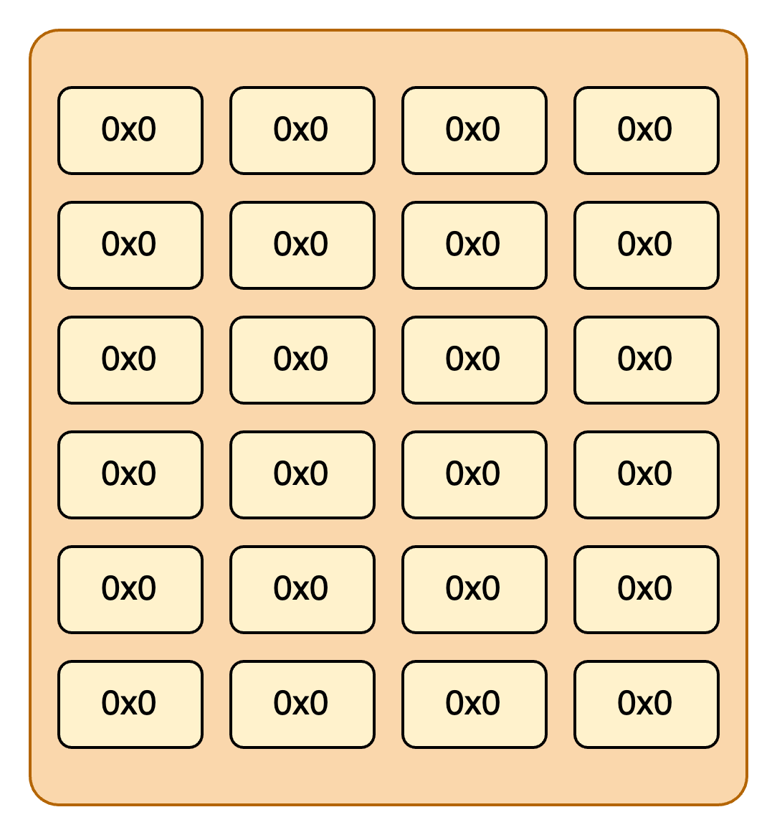
开源众包验证实践效果
Basic Function
Initial RTL
(xiangshan) xload ready-to-run/spike-dasm
# init memory info
(xiangshan) xflash ready-to-run/xspdb_flash_init.bin
# init flash info
Memory Disassembly
Reg information
49
Notes:
You can initialize the memory and register configuration data by entering the following two commands.

Slide 50
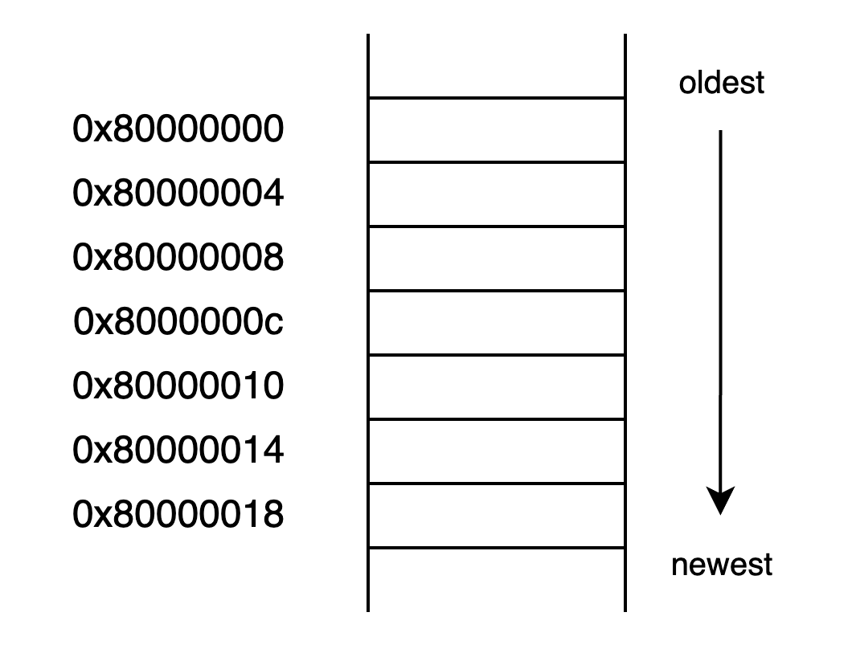
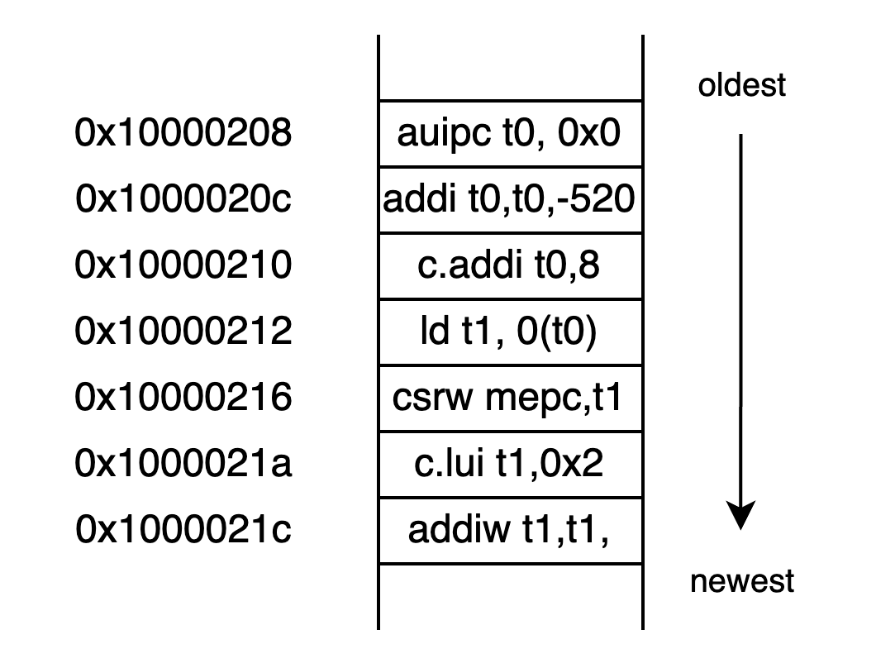
开源众包验证实践效果
Basic Function
drive RTL by cycle or inst
(xiangshan) xstep
# drive RTL by cycle
(xiangshan) xistep x3
# drive RTL by Inst
Memory Disassembly
Reg information
Reg information
50

Slide 51
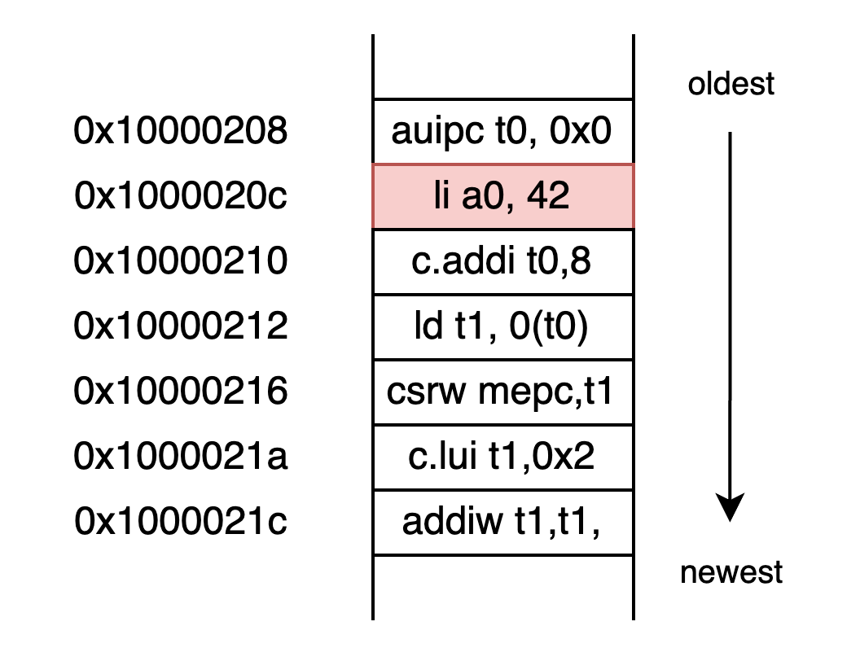

开源众包验证实践效果
Basic Function
script
(xiangshan) cat example/case1.script
# Display the script file
(xiangshan) xload_script example/case1.script
# Load the script file
Memory Disassembly
52
Notes:
cp file to $home
cd $home
List project Structure:tree –d –L 1
cd project

Slide 52


开源众包验证实践效果
Basic Function
Load instruction
(xiangshan) cat example/case2.inst
# Display the instruction file
(xiangshan) xload_instr_file 0x8000020c example/case2.ins
# Load the instruction file
Memory Disassembly
Memory Disassembly
case2.ins
53
Notes:
cp file to $home
cd $home
List project Structure:tree –d –L 1
cd project

Slide 53


开源众包验证实践效果
Basic Function
Watch & break Signal
(xiangshan) xwatch_commit_pc 0x10000210
# set breakpoint with commit pc
(xiangshan) xstep 200
# drive rtl 200 cycles
It will stop at pc 0x1000210
Summary information
54
Notes:
cp file to $home
cd $home
List project Structure:tree –d –L 1
cd project

Slide 54


开源众包验证实践效果
Example
Hands-on:
We inject a bug in a pre-built XiangShan processor
Now,let`s trigger it by XSPdb
Showcase
if t0 is odd number：
a0 + 1
else：
a0 + 0
55
Notes:
assembly program​

Slide 55


开源众包验证实践效果
Basic Function
error result & how trigger it
cat example/case2.script
# error result script
cat example/case3.script
# stop at
56

Slide 56



Thanks for your time
Group
Website
Tutorial

